Slide 1


© Open Mainframe Project. a Linux Foundation Project. All Rights Reserved. The Linux Foundation has registered trademarks and uses trademarks. For a list of trademarks of The Linux Foundation, please see our Trademark Usage page. Please refer to Marketing and Branding Guidelines for name usage guidelines. Linux is a registered trademark of Linus Torvalds. Privacy Policy and Terms of Use
Zowe™, the Zowe™ logo and the Open Mainframe Project are trademarks of The Linux Foundation.
Notes:
Zowe is owned and managed by the linux foundation, as part of the open mainframe project
<Click>

Slide 2
Open
Simple
Familiar
Notes:
Its goal is to provide a platform for access to the mainframe using tools that are
<click to animate text>
Open
Simple
Familiar
<click to introduce red border around zowe.org graphic>
Information about Zowe can be found at zowe.org

Slide 4
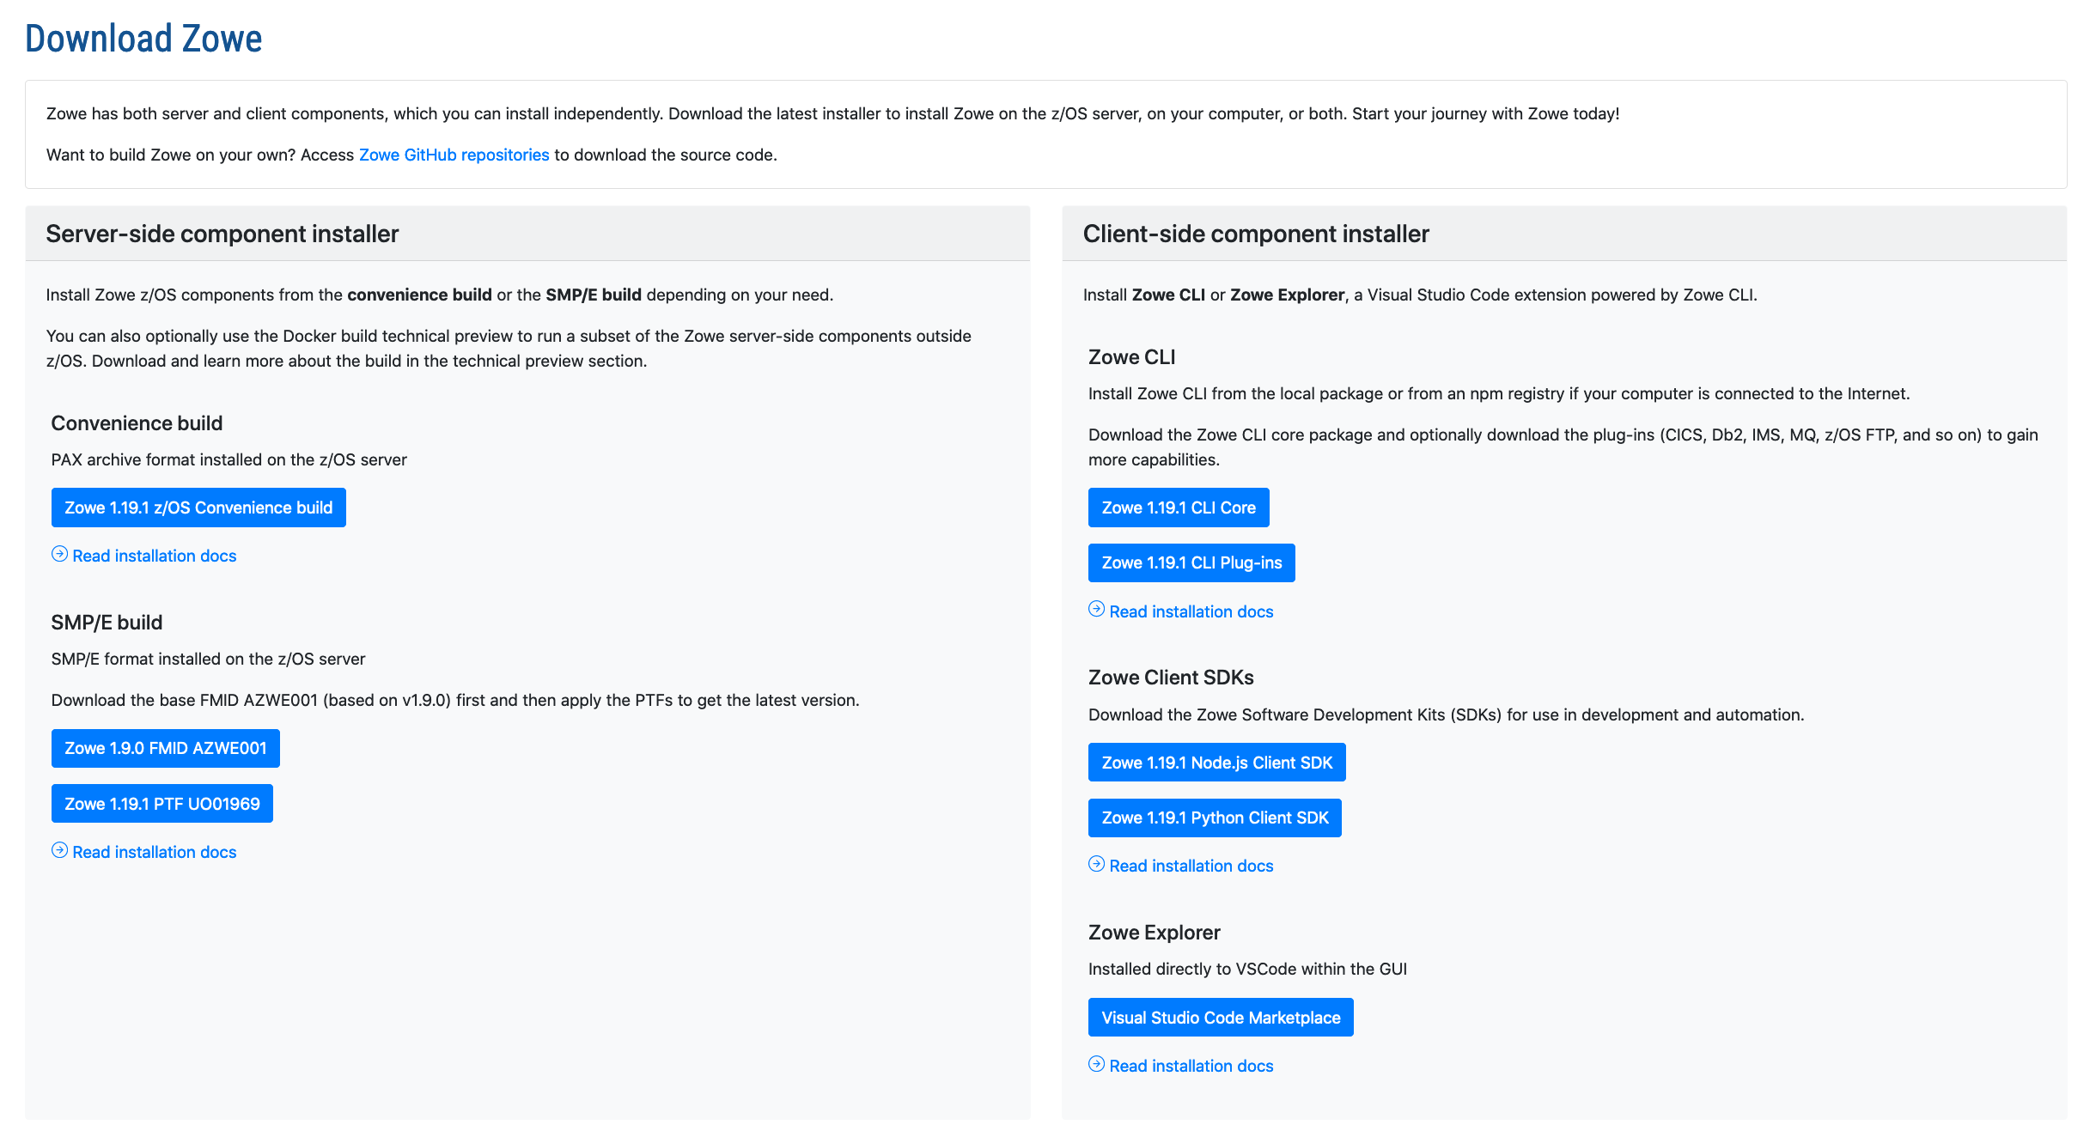
Notes:
Including links to downloads

Slide 5
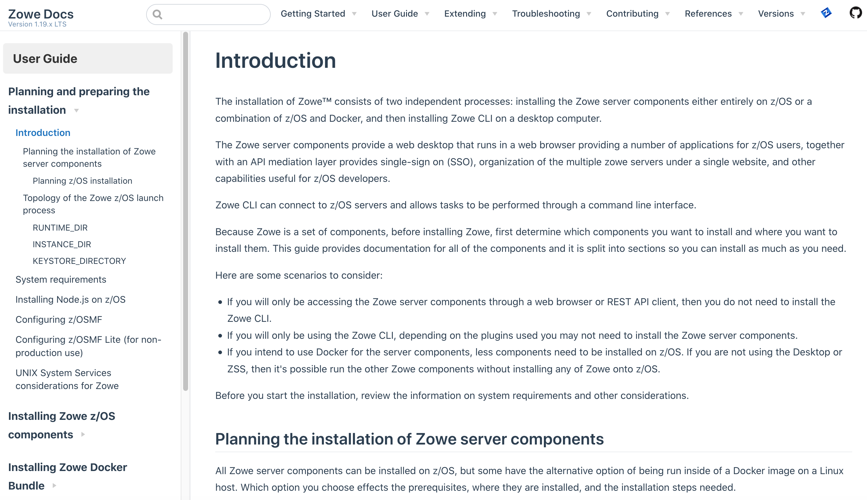
Notes:
documentation

Slide 6
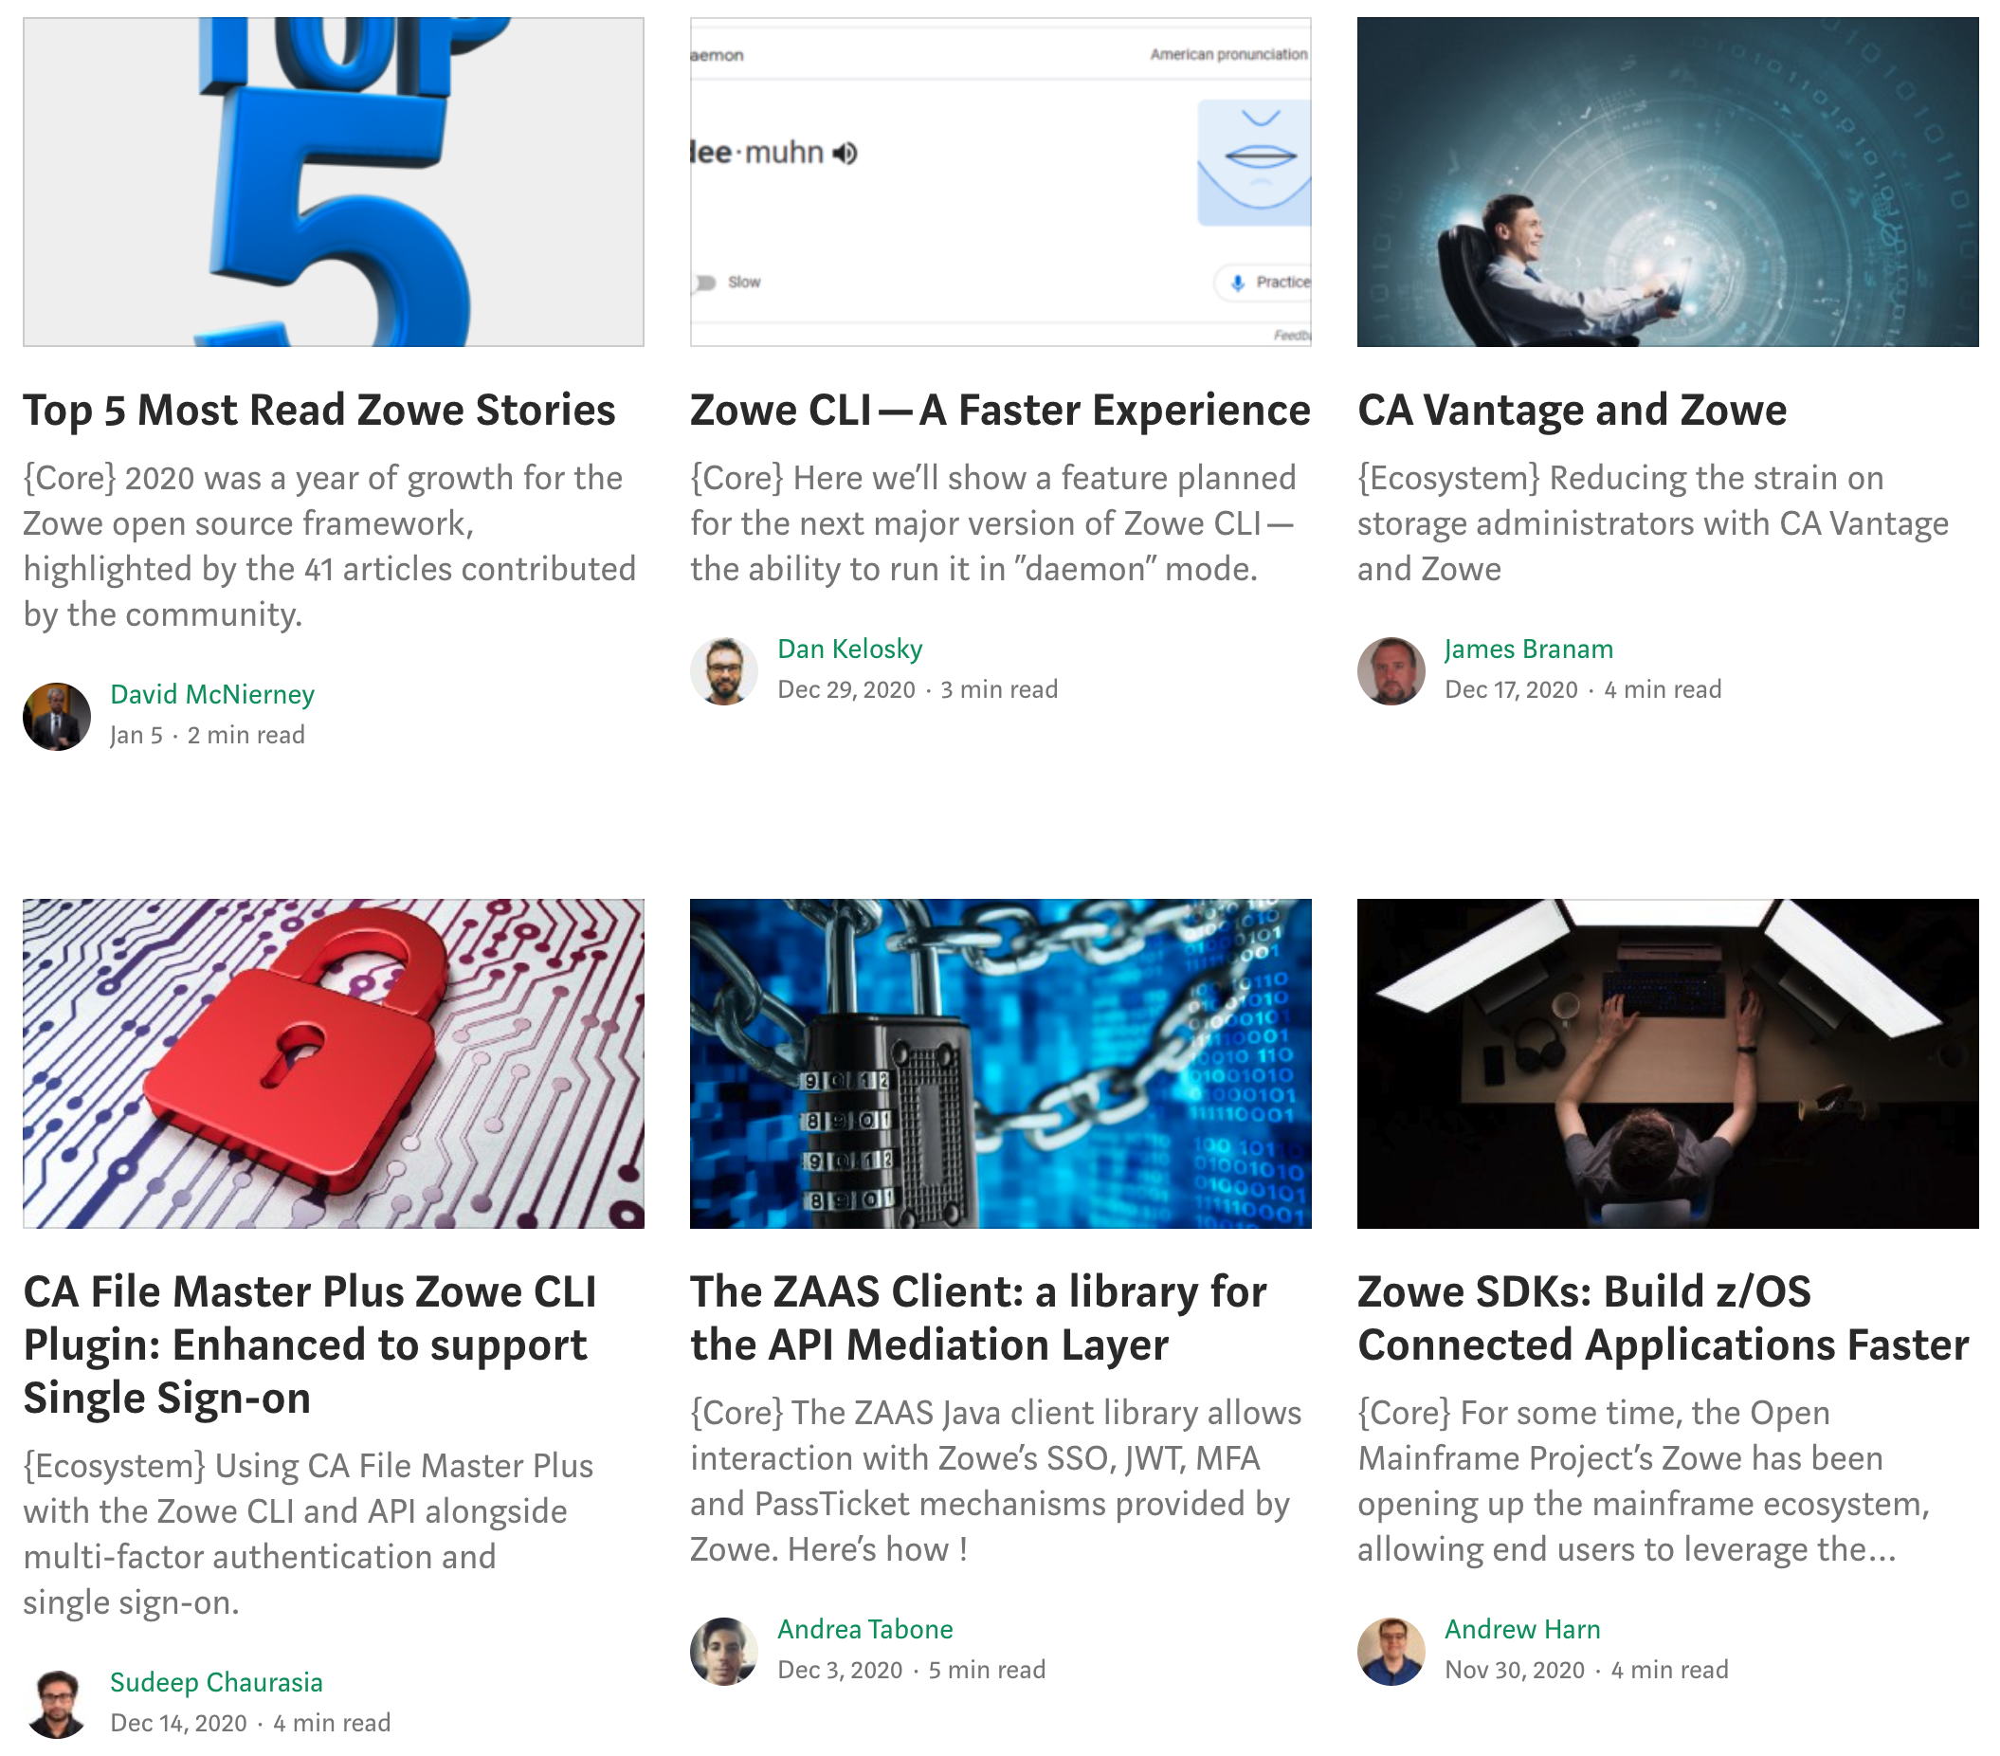
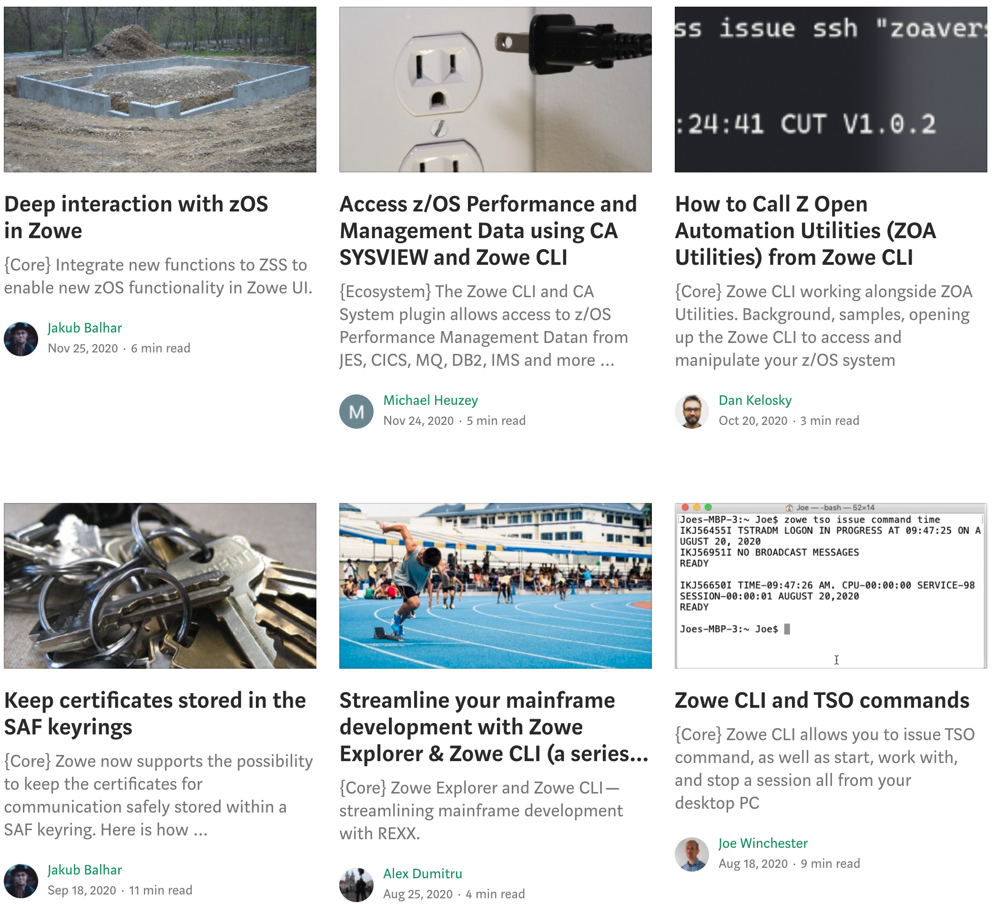
Notes:
technical blogs

Slide 7
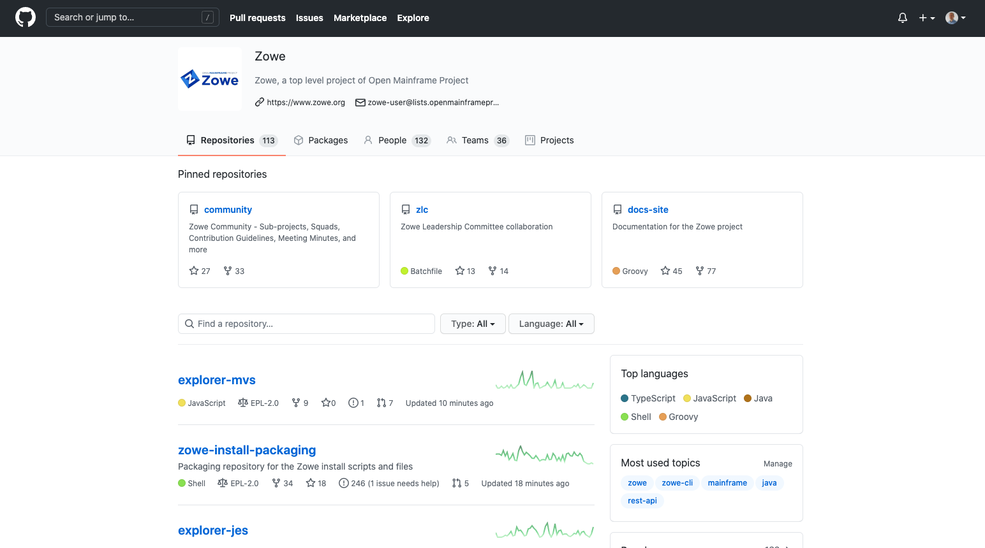
Notes:
As well as github repositories where all of Zowe’s open source code is developed and maintained by its community of committers

Slide 8
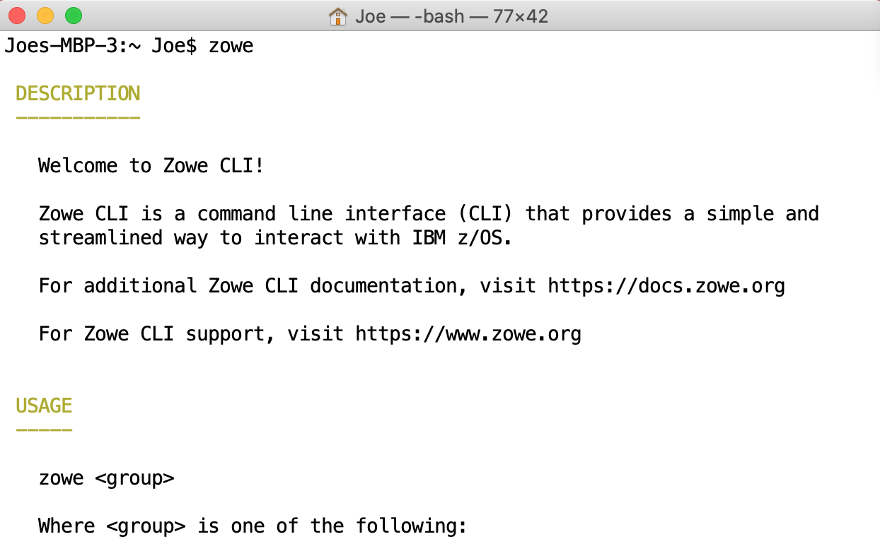
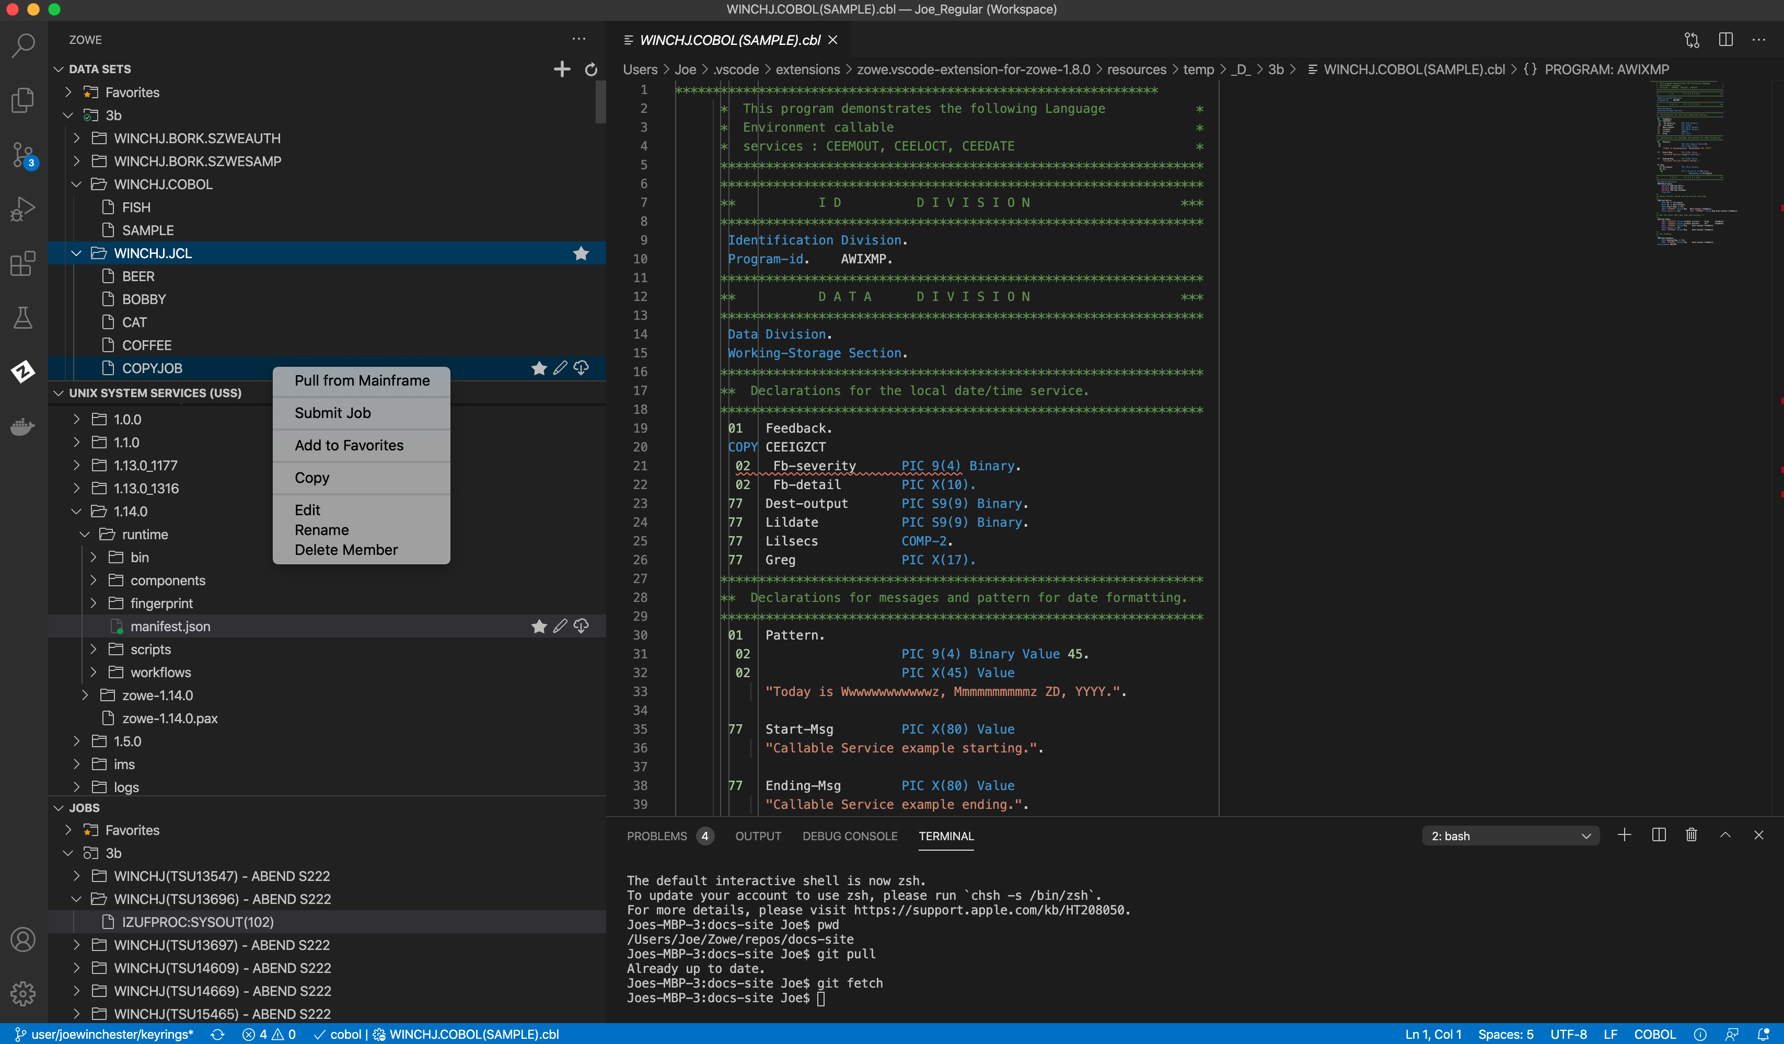
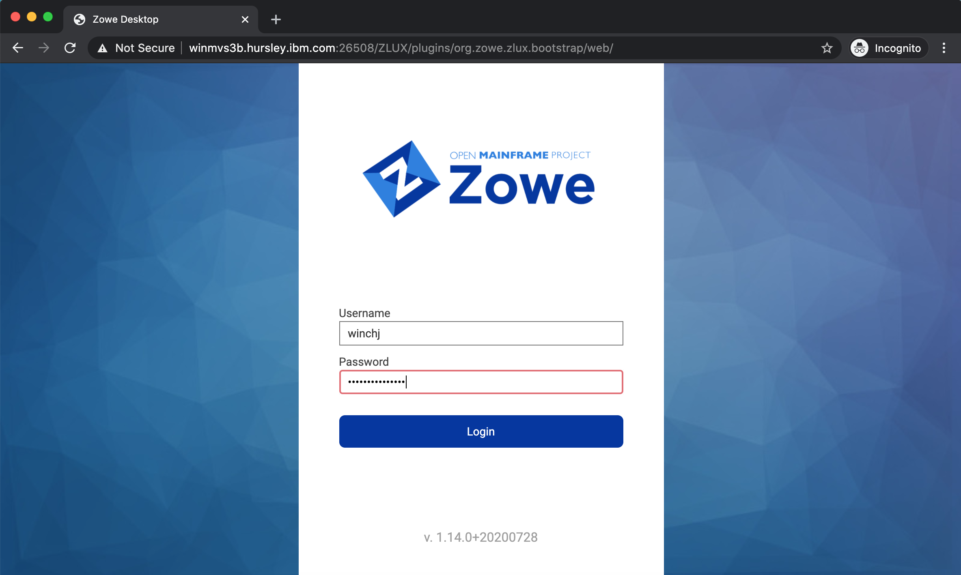
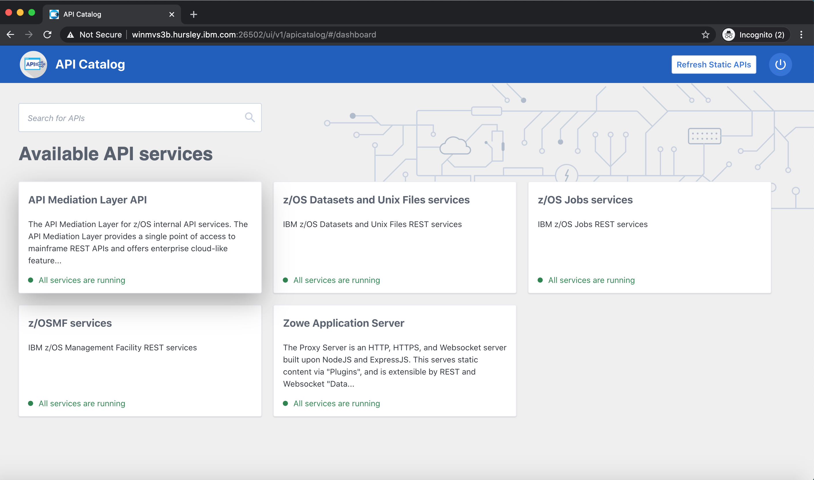
Notes:
Zowe is composed of four main components
<click>
A command line interface
<click>
A visual studio code extension known as the Zowe Explorer
<click>
A web user interface accessible through a desktop browser
<click>
And a powerful API Mediation Layer
Let’s look at each of these in more detail.

Slide 9
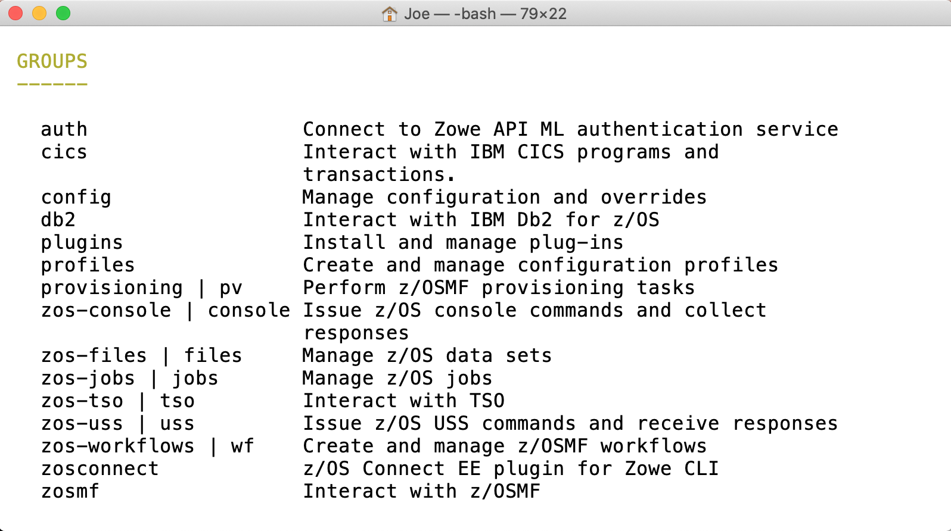
Command Line Interface
Notes:
The command user interface, or CLI, allows a user to issue commands from their PC to directly operate and manage their mainframe.
<click>
CLI commands are broken down into groups. The core set includes groups to work with
<click>

Slide 10
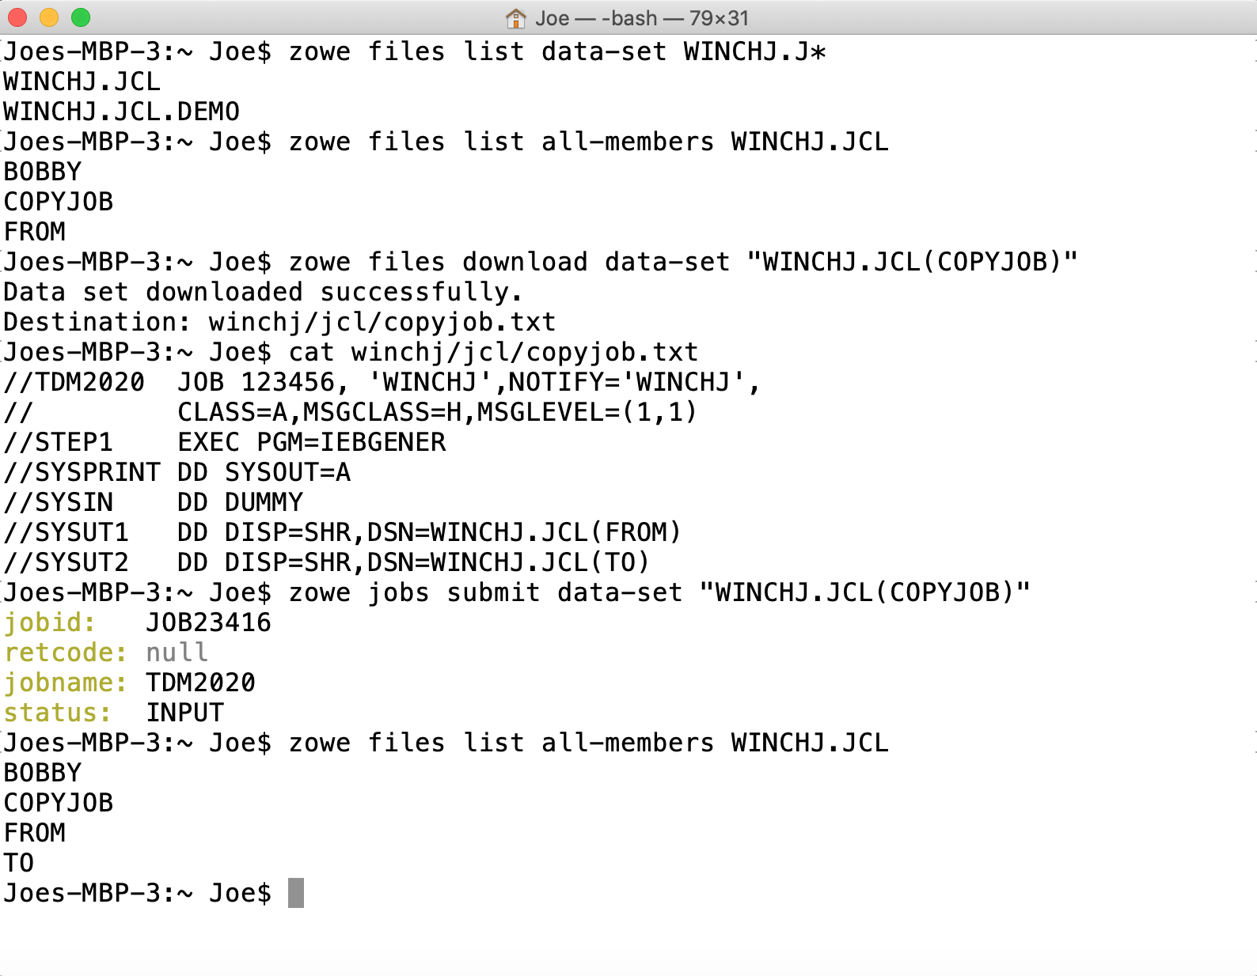
Data sets
Notes:
Data sets, where you can
<click>
list data sets for a file
<click>
List the members of a PDS
<click>
download members to your PC
<clicl>
And submit job control language data sets to the JES queue

Slide 11
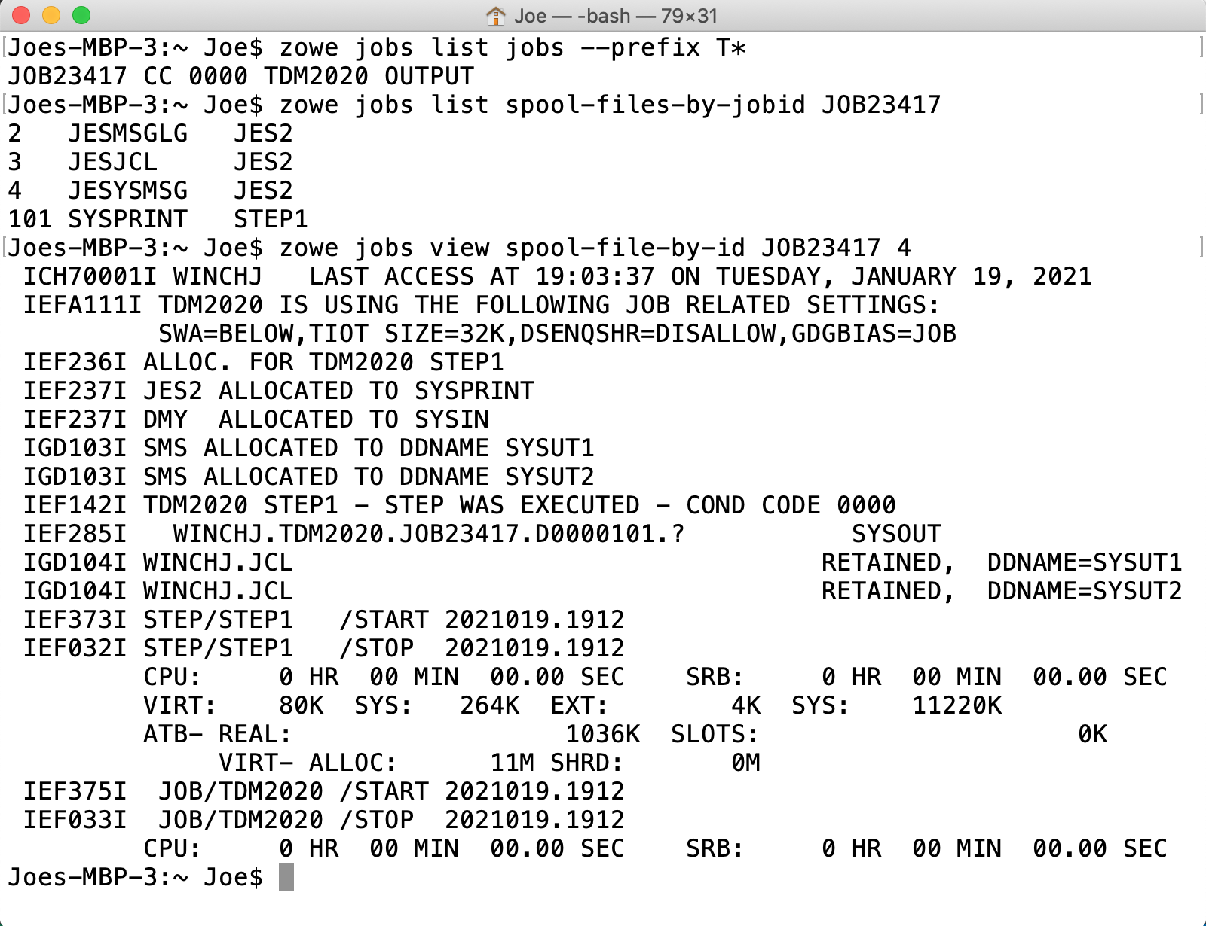
Jobs
Notes:
The jobs groups allows you to
<click>
List jobs by prefix, owner or status
<click>
View a list of spool files
<view>
As well as content for an individual spool file
<click>

Slide 12
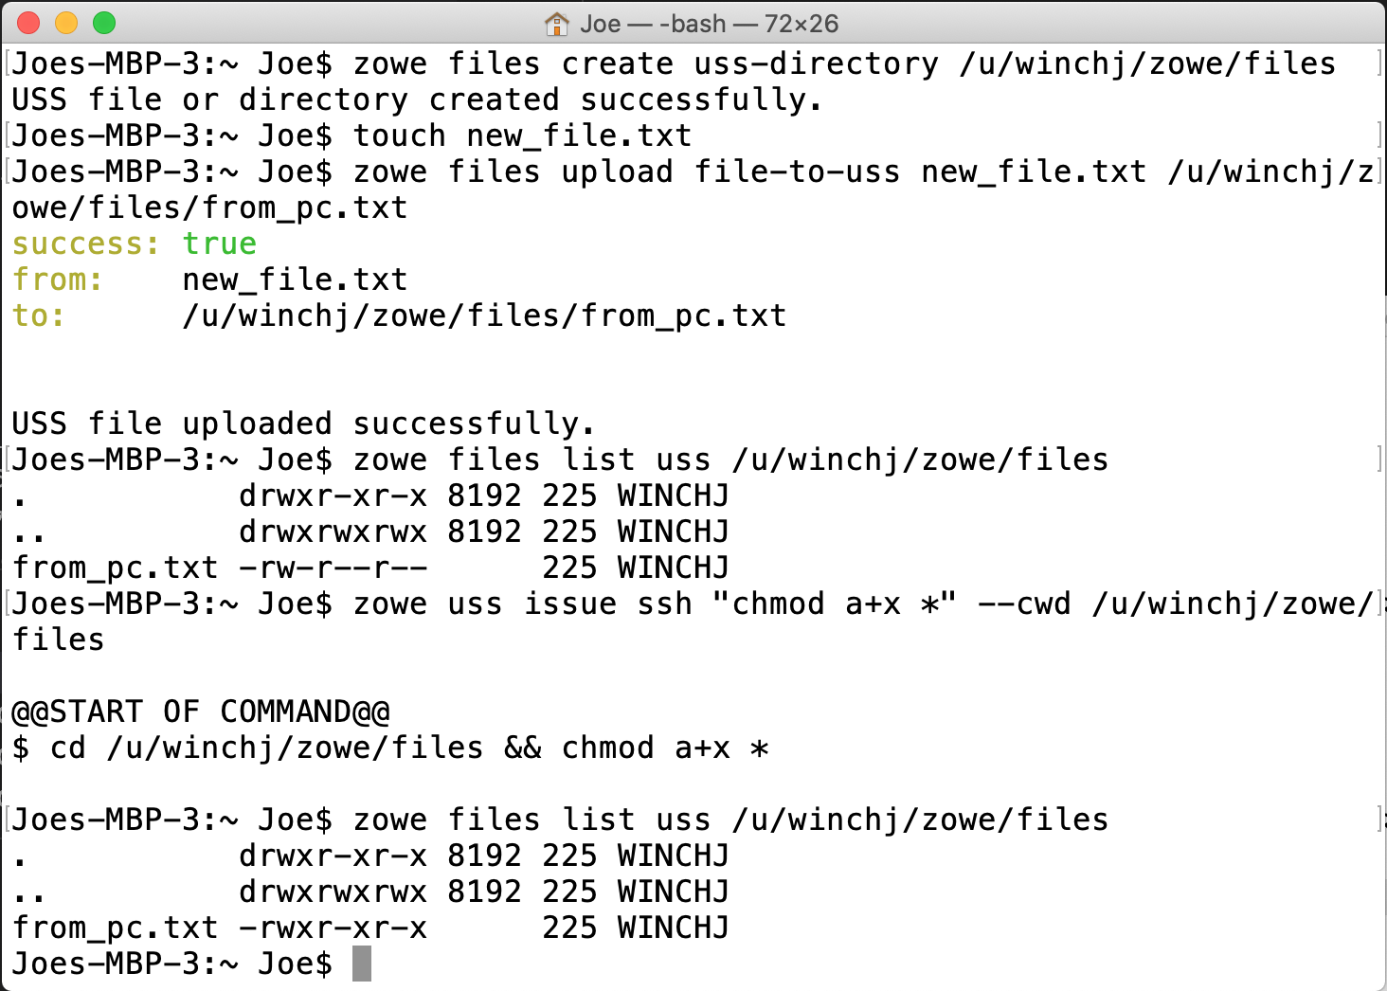
USS
Notes:
With the unix system services group you can
<click>
Create directories
<click>
Upload files from your PC
<click>
As well as issue unix commands directly within USS

Slide 13
Command Line Interface
Notes:
Other core command groups allow you to issue
<click>
TSO commands, create and manage workflows
Bec

Slide 14
DevOps
Continuous Integration Continuous Delivery Pipelines
Automation
Orchestration Scenarios
Secure Encrypted Communication
Laptop’s native credential store
Notes:
Because the CLI is running on the user’s laptop it can be embedded and executed from other tools within the same machine
Such as those for
<click>
DevOps
CICD Pipelines
Automation scripts
And other scenarios where mainframe orchestration is required
This allows a developer familiar with their existing software suite to seamlessly use the Zowe CLI to perform mainframe tasks
<click>
All of this is done with encrypted communication using the laptop’s native credential store

Slide 15
Command Line Interface
Notes:
As well as core capabilities Zowe CLI is built to be an extensible framework allowing additional plugins to be installed, such as those for
<click>
CICS
<click>
DB2 and other mainframe runtimes.
This is done using an extensible API so that

Slide 16

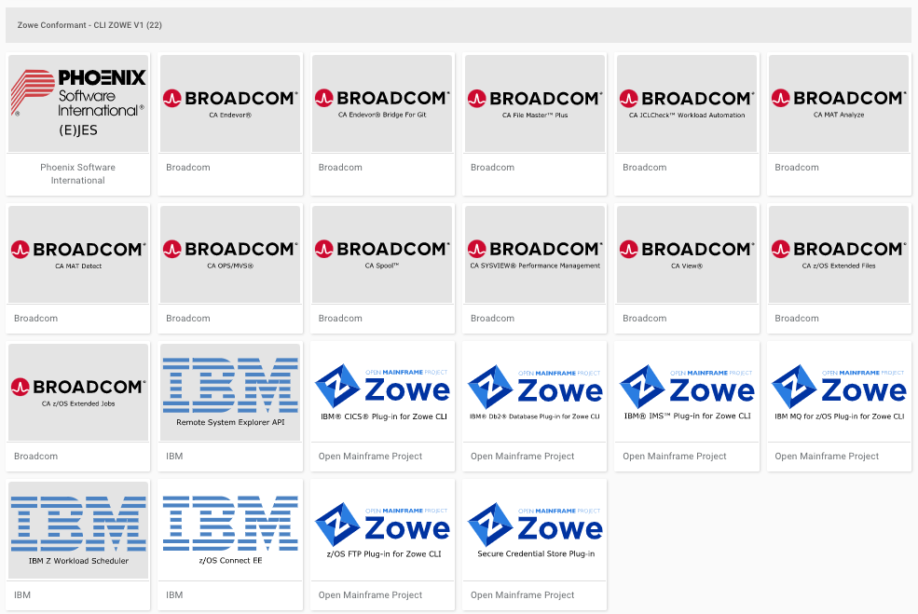
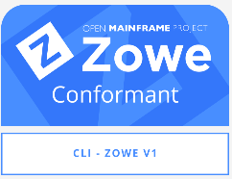
Notes:
Software vendors can built their own CLI plugins using these fully supported interfaces and extension points.
<click>
The Zowe conformance program is a certification process that issues badges to extensions who are built, packaged and execute using these APIs.
This ensures ensuring consistency of end user experience and compatibility between plugins
A number of extensions are available from vendors including
<click>
CA Endeavor, I
<click>
BM z/OS Connect
<click>
Phoenix Software EJES, and more

Slide 17

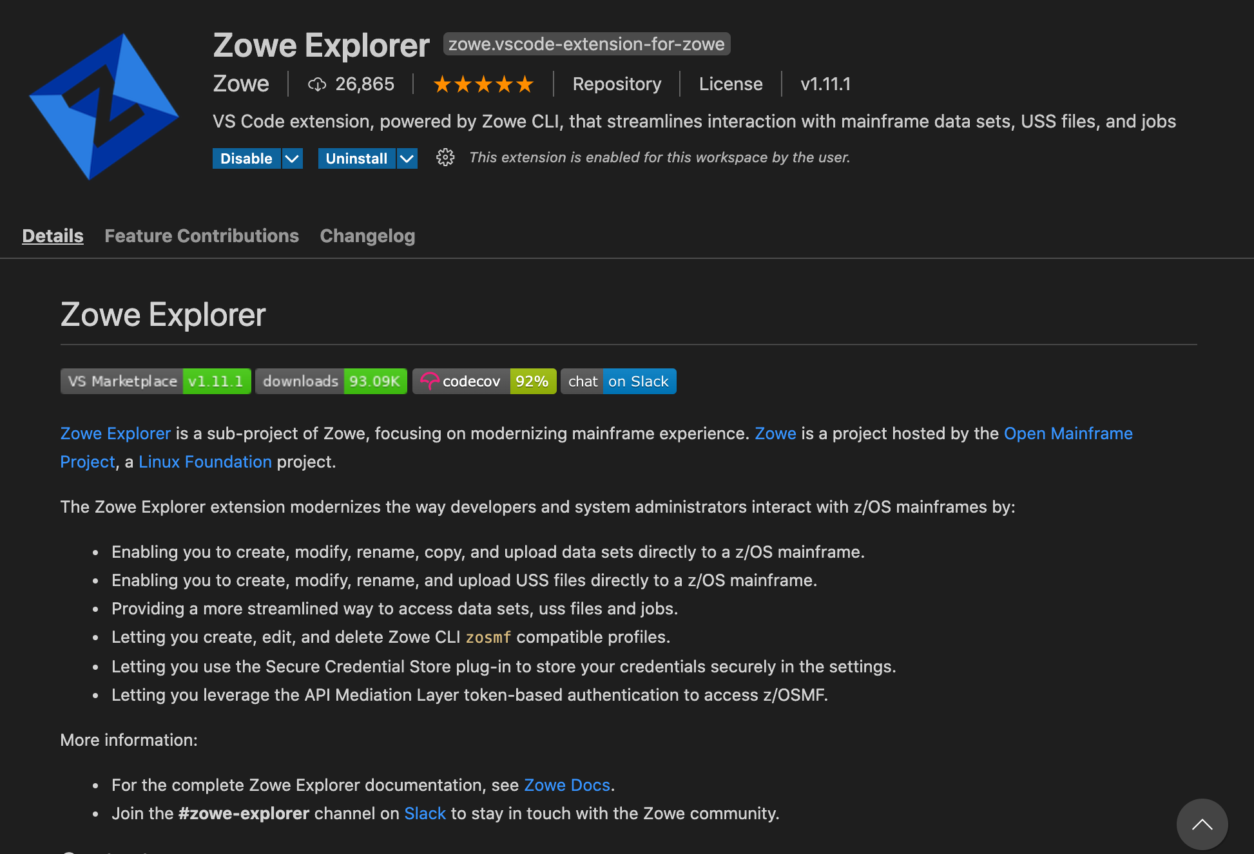
Zowe Explorer
Notes:
The second component to look at is the Zowe Explorer, an extension to the popular Visual Studio Code Integrated Development Environment.
With the Zowe Explorer installed
<click>
it can be launched from the Zowe icon in the VS Code sidebar

Slide 18
Notes:
The Zowe Exolprer has three navigator views for
<click>
Data sets
<click>
Unix System Services
<click>
And Jobs
Let’s take a quick tour of each one

Slide 19
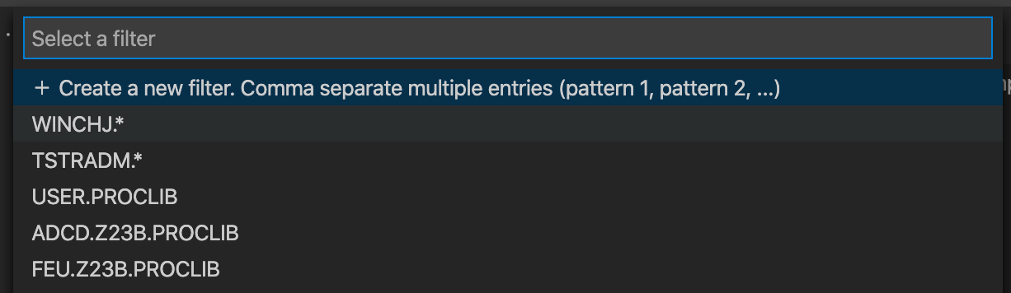
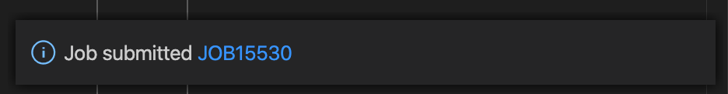
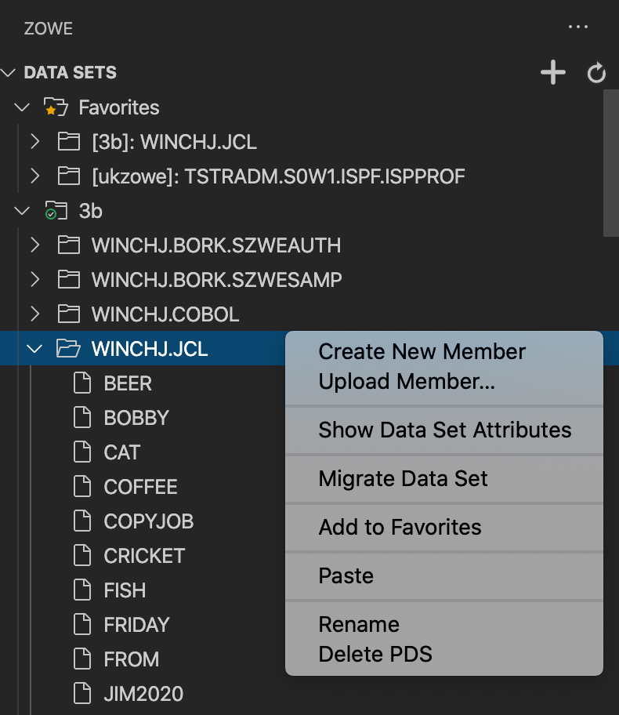
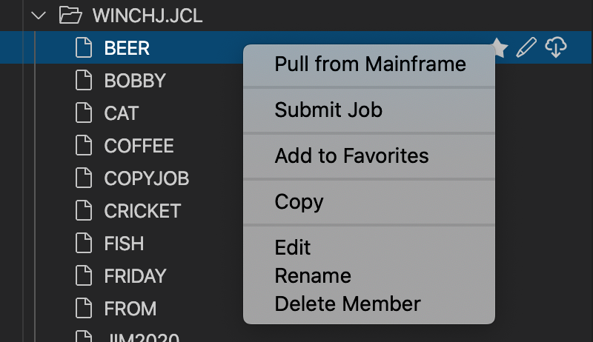
Notes:
<click> The list of data sets can be filtered
<click> showing a tree view of that allows you to expand into the members of a partitioned data set, together with a pop-up menu of actions for create, rename, delete and more.
<click> The menu for a PDS member allows you to
<click> submit submit it as a job
<click> which brings up a hyperlink with the job ID you can select to directly open its spool files.

Slide 20
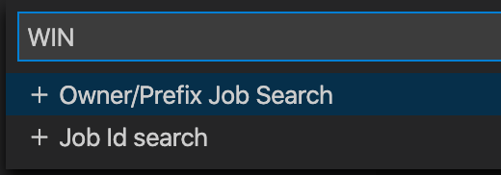
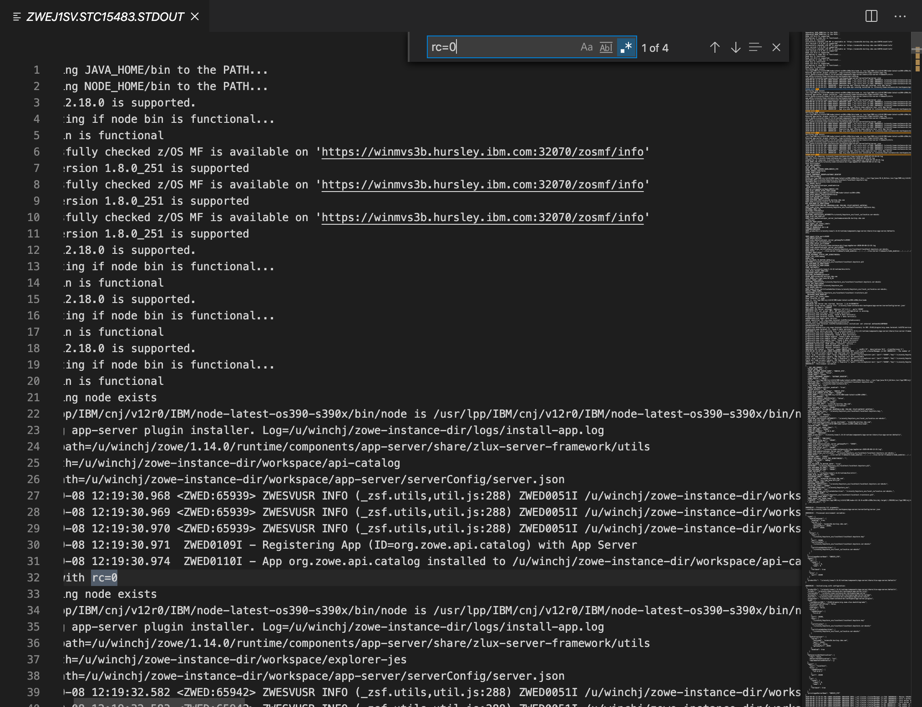
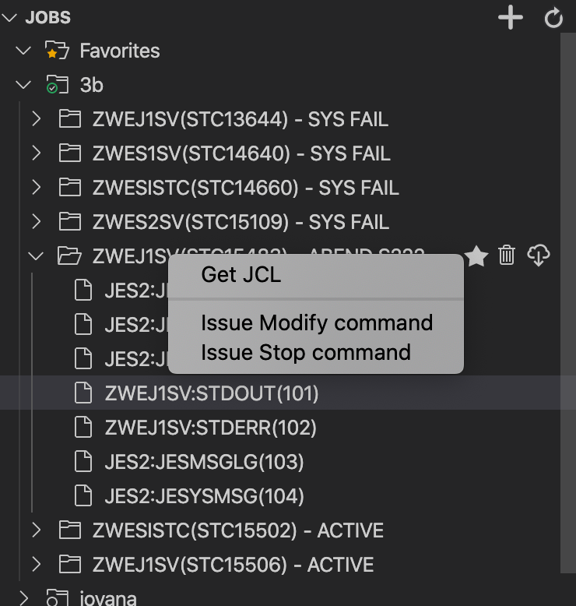
Notes:
<click>
The jobs navigator allows you to filter by Owner and Prefix, or Job ID.
<click>
Jobs can be expanded to see their spool files
<click>
Which are opened in the editor area, allowing you to use VS code features such as searching for strings or navigate the spool file using the overview pane

Slide 21
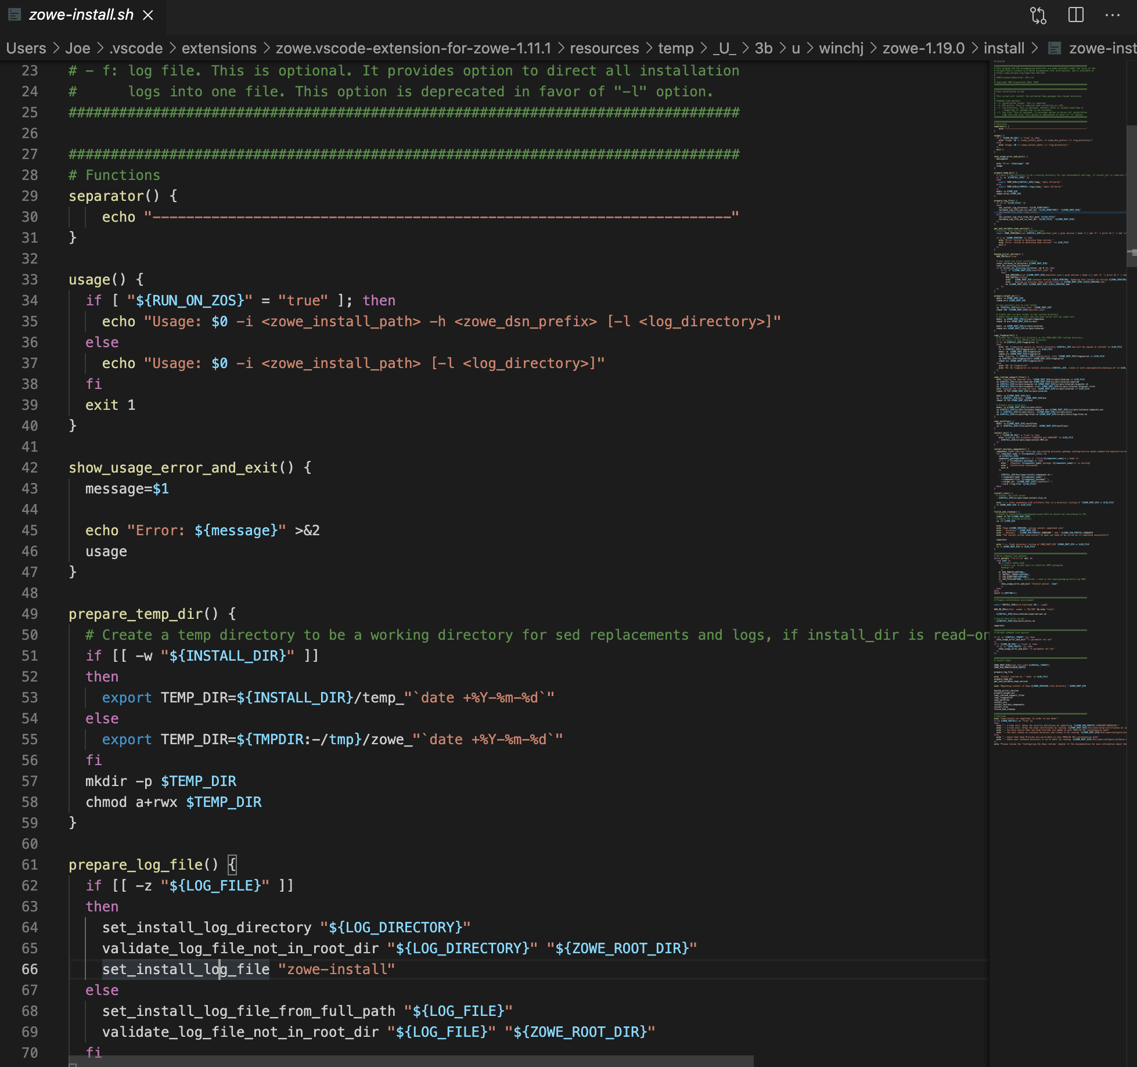
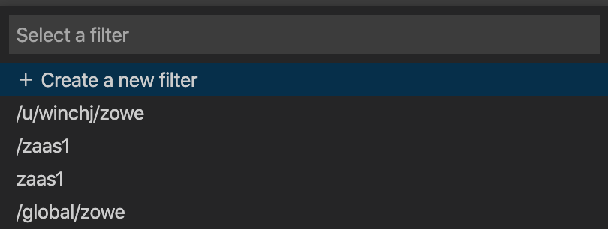
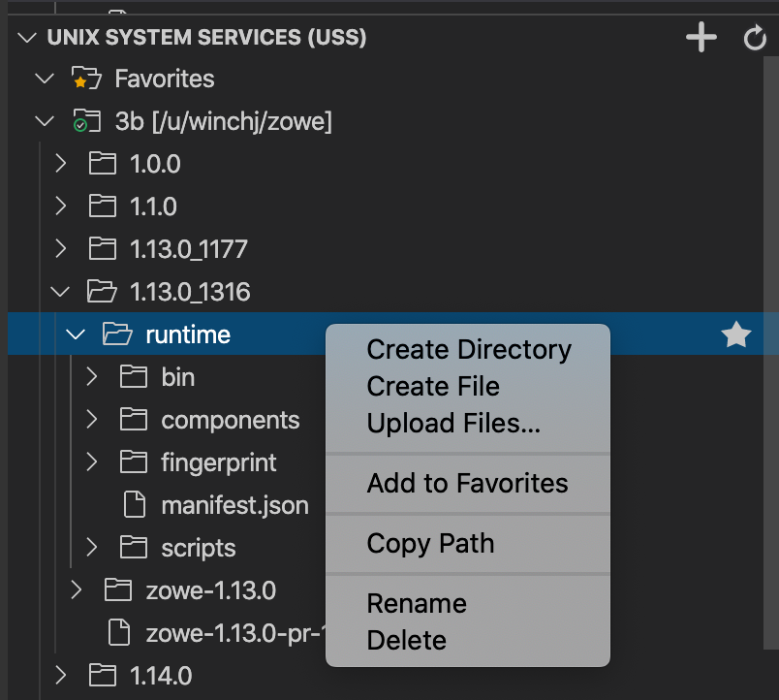
Notes:
<click>
The top level USS directory can be set as a filter
<click>
And the navigator lets you expand into directories showing sub directories and files.
The pop-up menu of actions includes
<click>
The ability to upload files from your PC directly
<click>
As well as open files in the editor area allowing you to make changes that get saved directly back to the mainframe

Slide 22
Mainframe data and JES access from VS Code
Rich language editors
Powerful integrated development environment
Notes:
<click>
The Zowe Explorer is an example of where a user who is already familiar with VS Code is able work with mainframe data directly from within their IDE
<click>
Viewing and editing files alongside other VS code plugins such as rich language editors or debuggers
<click>
Creating a powerful modern extensible tools workbench to enhance mainframe productivity

Slide 23
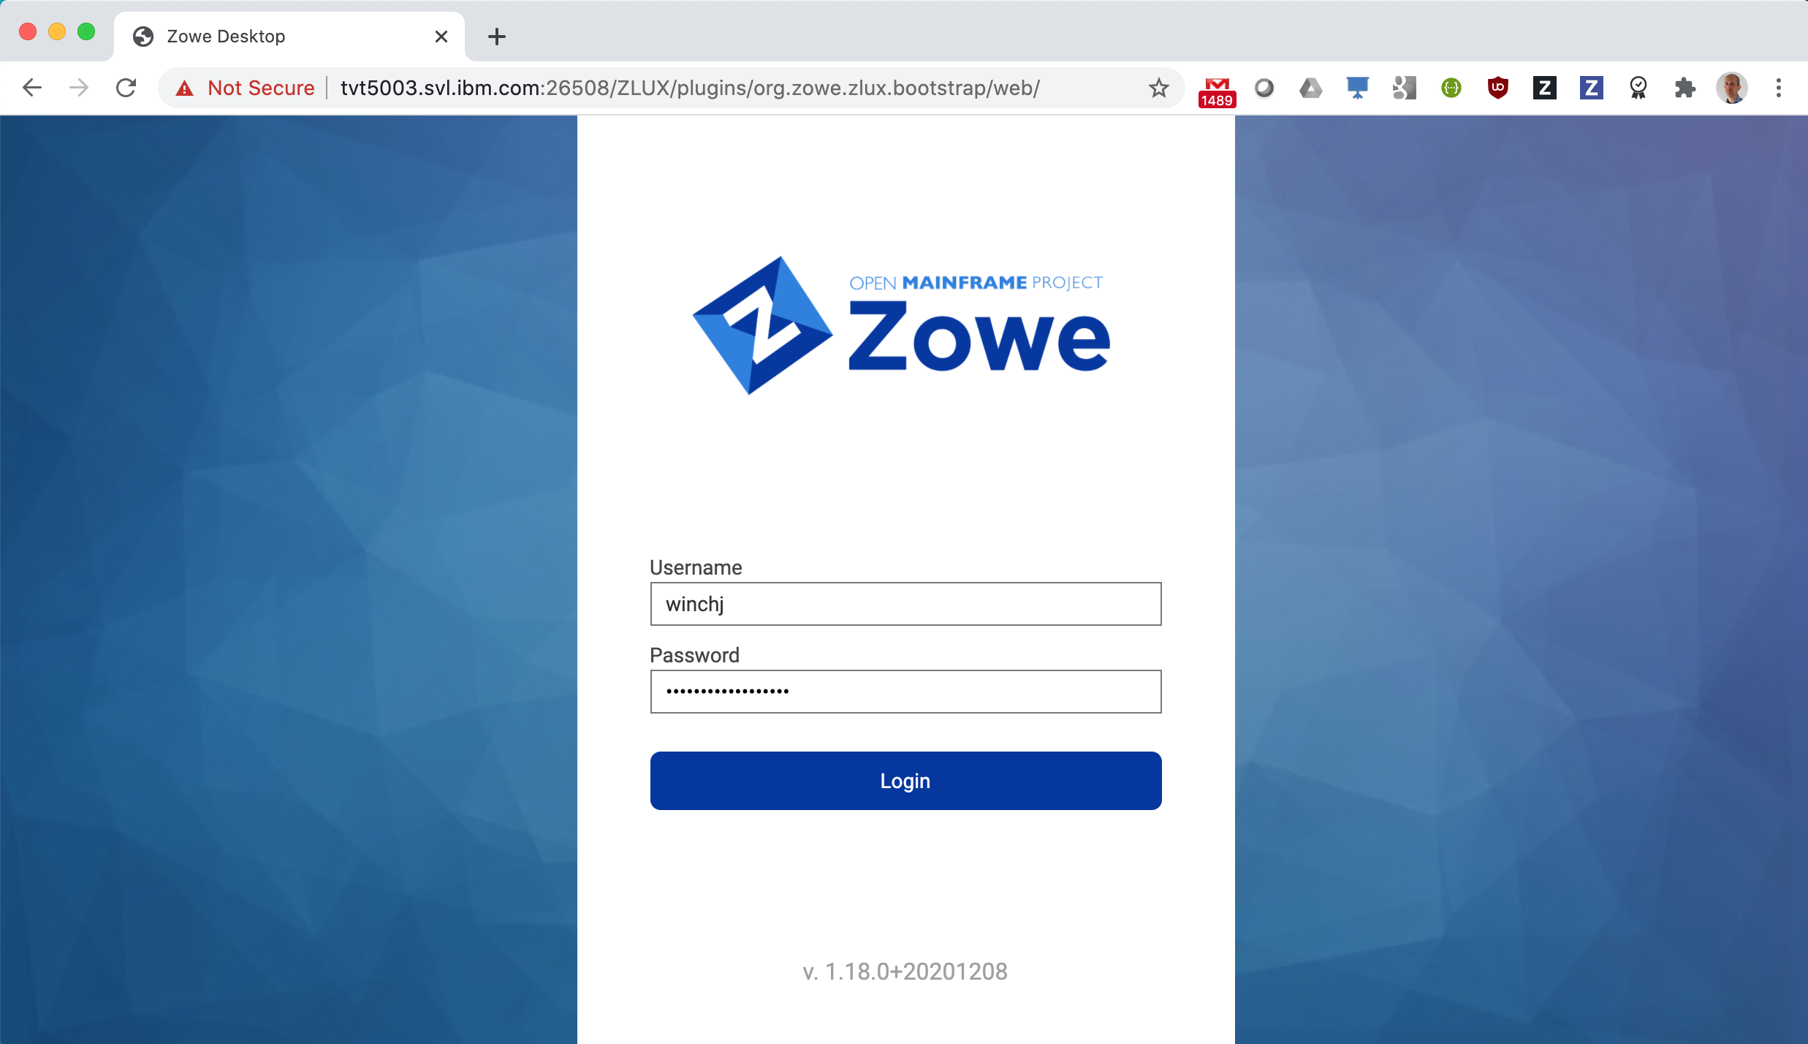
Zowe Desktop
Notes:
The third component to look at is the the Zowe desktop
allows access to mainframe data and services using nothing more than a standard web browser
<click>
Users log into the desktop with their TSO user ID and password.

Slide 24
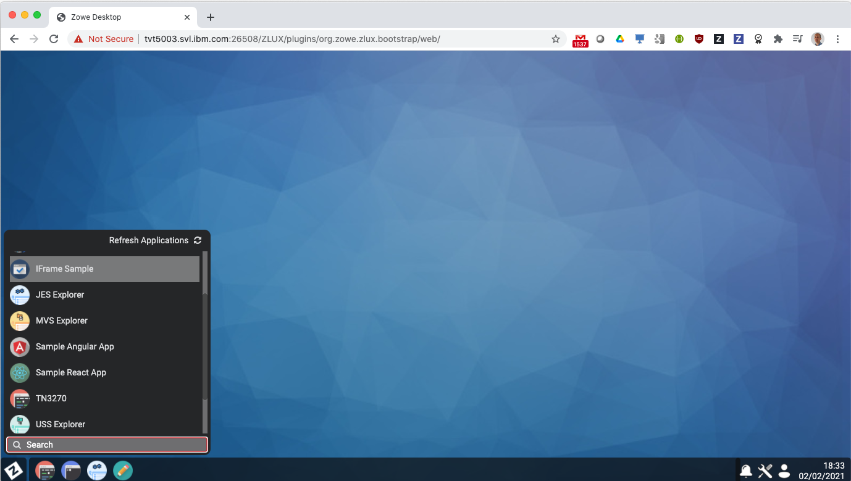
Notes:
Once logged into the Zowe desktop a flyout menu shows a list of the desktop’s available applications.
<click>
Frequently opened ones can be pinned to the bottom task bar, which includes a File Editor

Slide 25
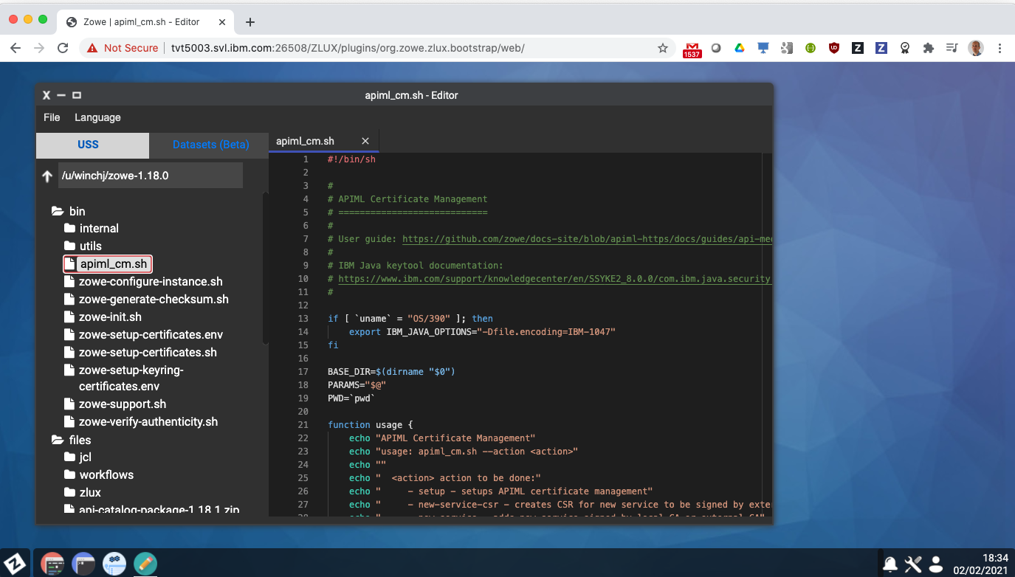
Notes:
The File Editor lets you
<click>
navigate USS directories and files
<click>
together with an editor pane that allows you to view and edit files.
syntax highlighting is provided for a number of files types which auto detects based on file extension
<click>

Slide 26
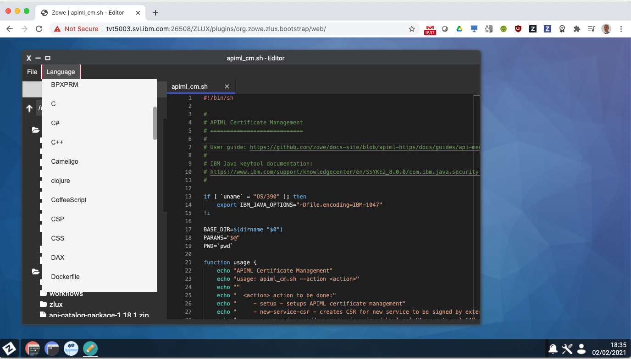
Notes:
but can also be manually selected to choose from a wide range of content types

Slide 27
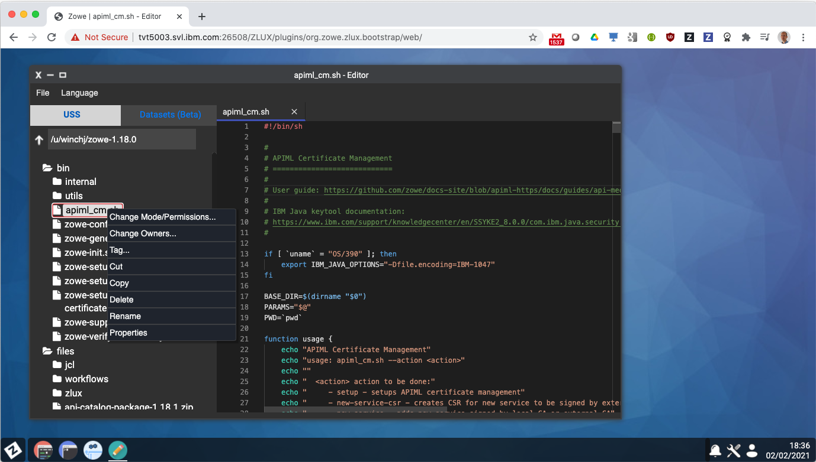
Notes:
The pop-up menu in the navigator tree has actions for , cutcopy and paste, in-place rename,

Slide 28
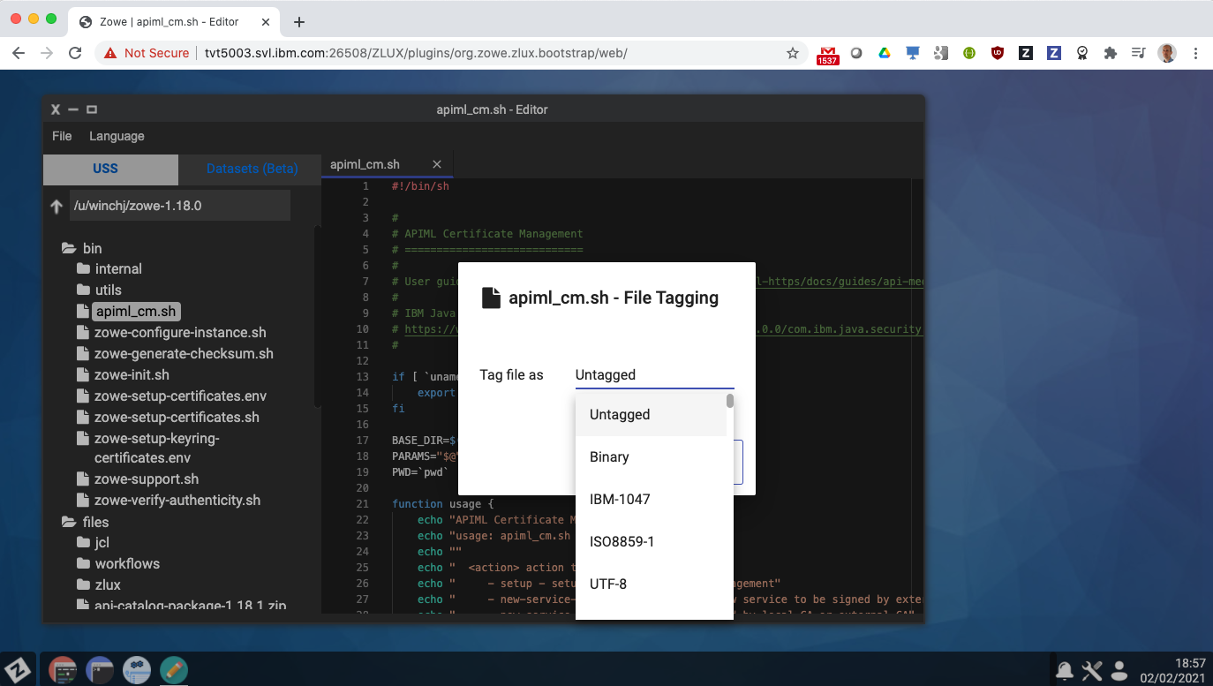
Notes:
The ability to set file tags

Slide 29
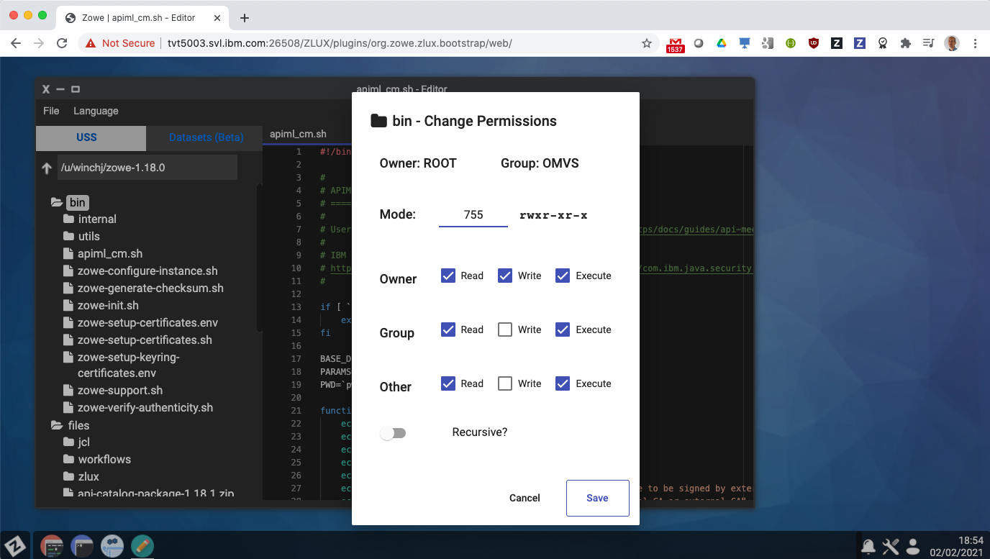
Notes:
As well as change ownership and permissions of files
<click>
and directories which allows recursive updates.
<click>
As well as working with USS the navigator and also work with data sets

Slide 30
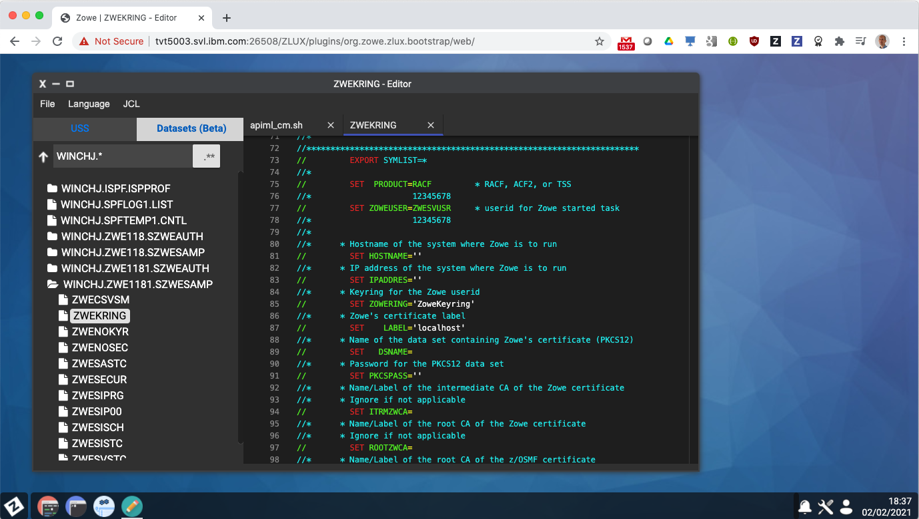
Notes:
<click>
This allows you to filter by high level qualifier to show data sets and their members.
<click>
The file editor includes syntax highlighting for JCL, REXX, assembler and other traditional mainframe languages
<click>
As well as rich GUI apps, the Zowe desktop includes more traditional mainframe interfaces, such as its 3270 emulator

Slide 31
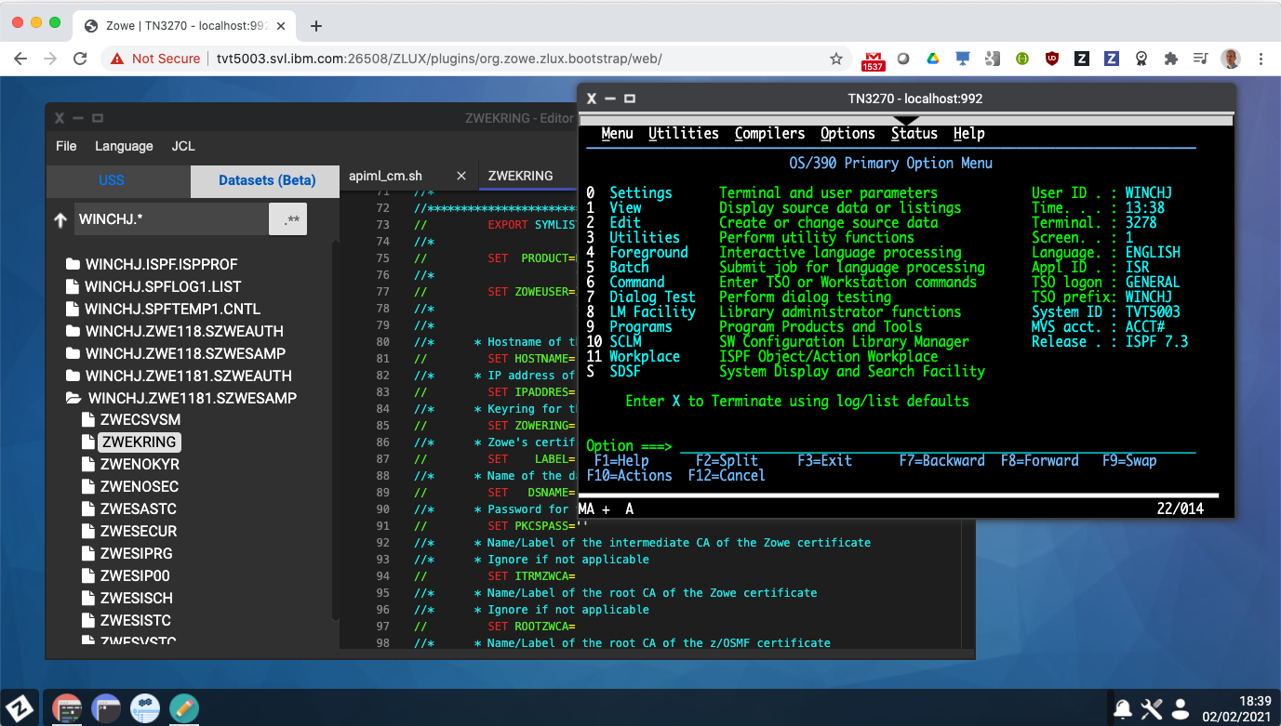
Notes:
From this you can work with TSO, ISPF, SDSF, RACF, and familiar commands.
Zowe deskop apps are opened side by side, allowing you to perform mainframe tasks with your preferred tool of choice.

Slide 32
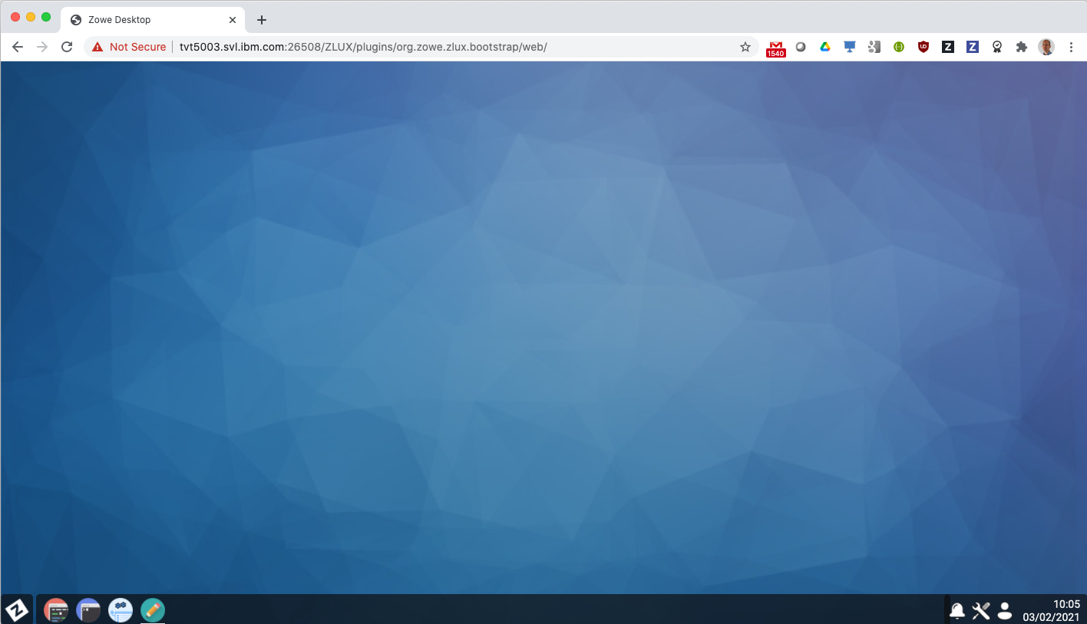
Notes:
Apps running in the desktop are connected to each other in a number of ways.
They work under the initial logon credentials so the user only has to enter their password once when operating desktop apps, also known as single sign-on which can operate with extended security processes such as multi-factor authentication or client side x509 certificates.
Apps share the same certificate to encrypt data and within the desktop are able to register endpoints to communicate with each other allowing app to app launching

Slide 33
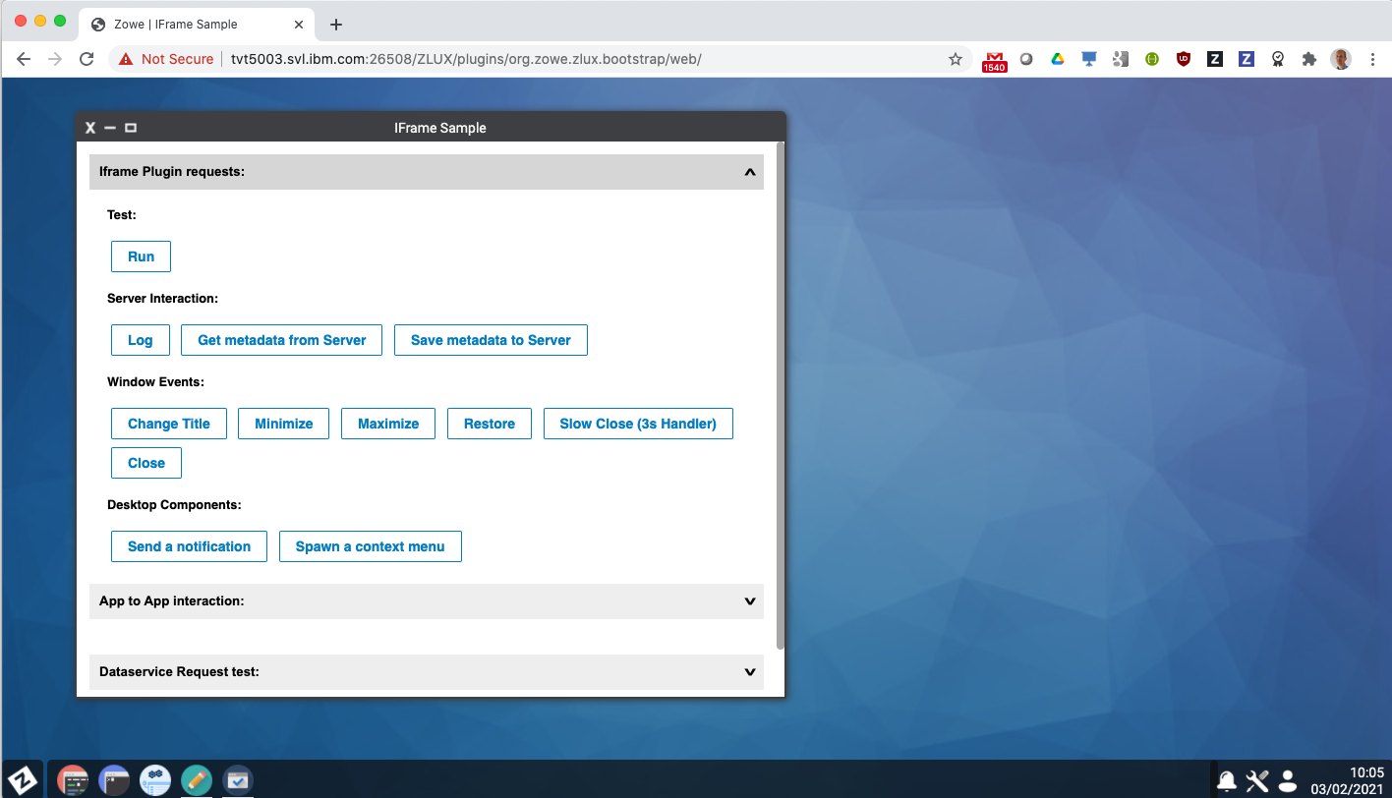
Notes:
App to app launching provides the ability for apps to notify each other, send requests, and interact with desktop services such as persistence
As an example of app to app communication
<click>

Slide 34
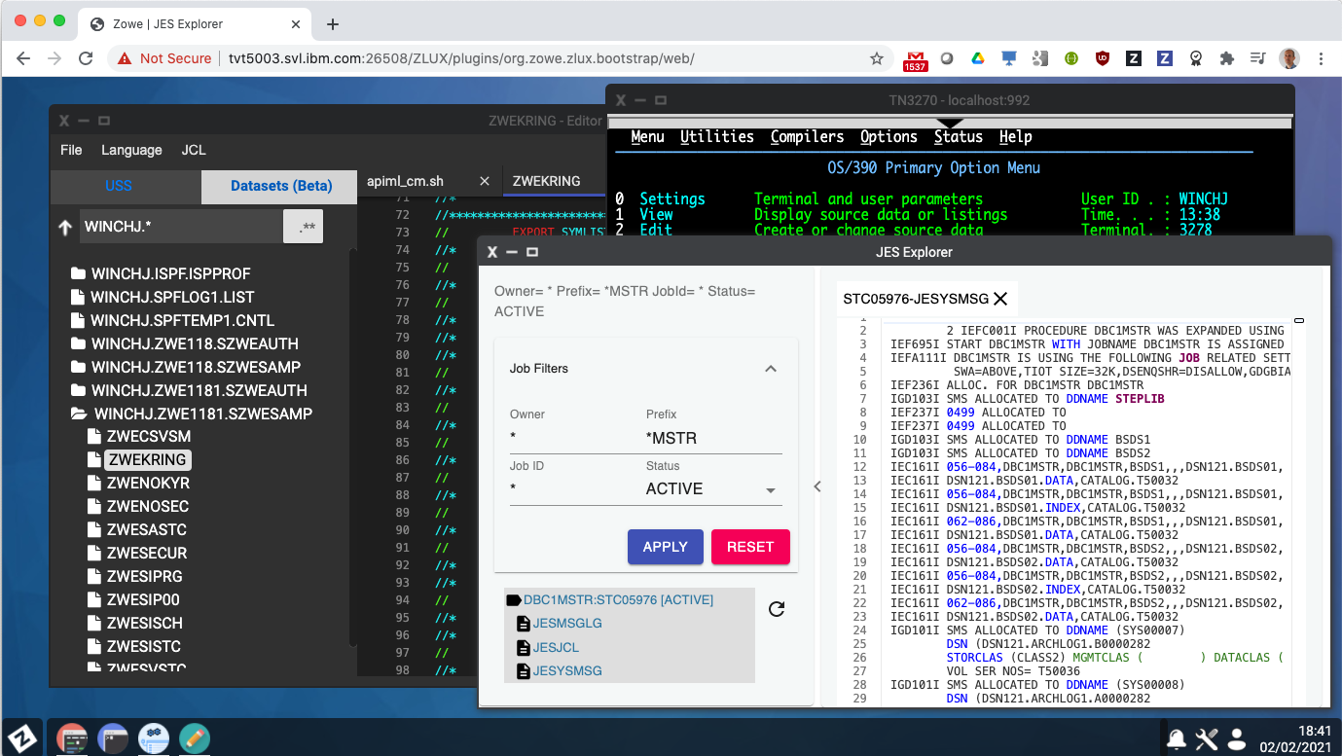
Notes:
the JES Explorer app on its own can be used to filter and find jobs to view their spool files and issue commands.
Running in the Zowe desktop it publishes endpoints for its services, which allows the scenario of a user submitting some JCL in the File Editor app, to then have the JES Explorer be opened in the context of the submitted job ID.
App to app communication in the desktop allows the end user experience to be greater than the sum of the parts of each app, providing a smooth transition and hand off of data and context for joined up tasks between desktop plugins

Slide 35
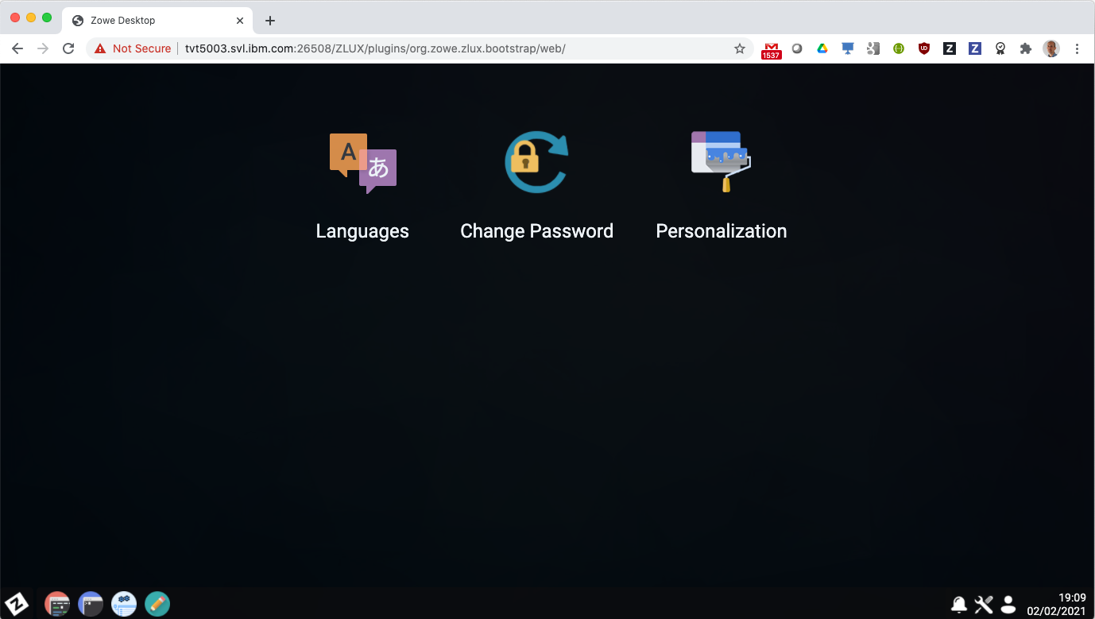
Notes:
The Zowe desktop includes utilities to switch languages,
<click>
Change the user’s TSO password
<click>
as well as personalization which provides the ability

Slide 36
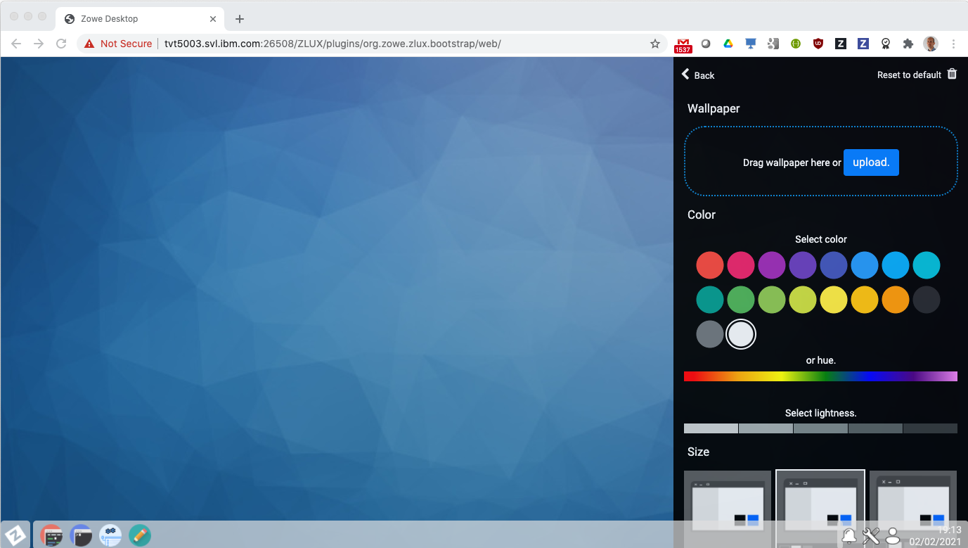
Notes:
To change the color theme and icon sizes for the desktop

Slide 37
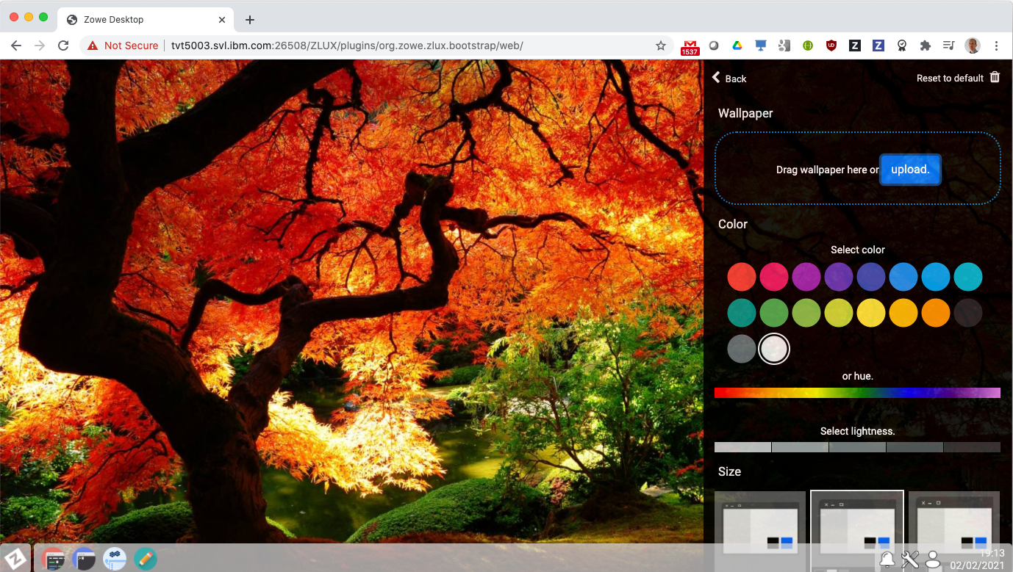
Notes:
Together with the ability to set a custom desktop

Slide 38
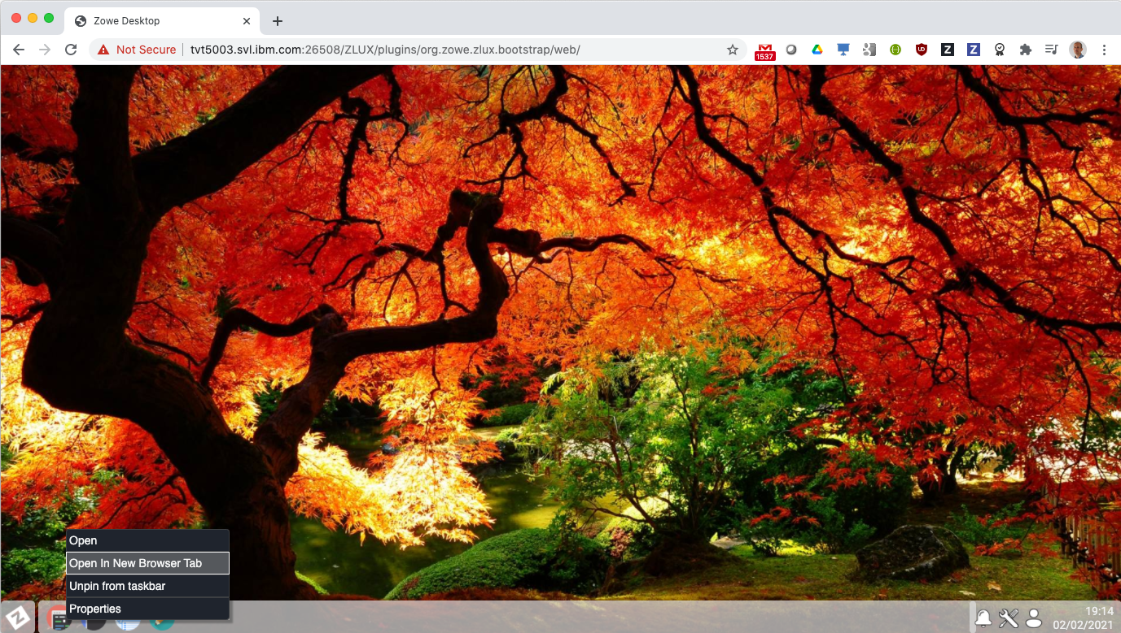
Notes:
Zowe desktop apps aren’t restricted to run as tiles, and can be opened in a new browser tab

Slide 39
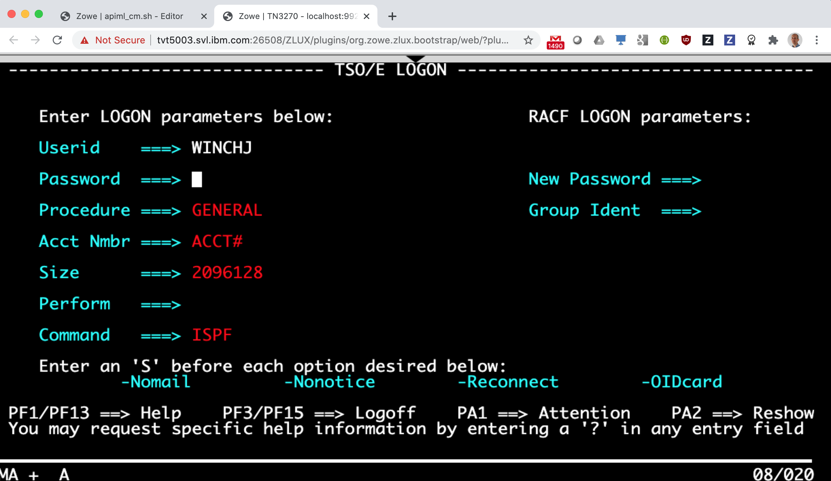
Notes:
When they can be used like any other web page in the browser.
A good use of this is for mainframers who are comfortable with 3270 interfaces, who can launch the emulator in a browser tab and access their mainframe without the need for any host emulation software on their laptop.

Slide 40
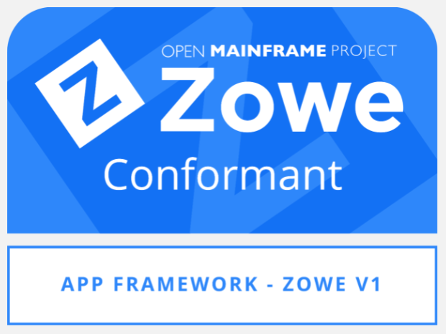

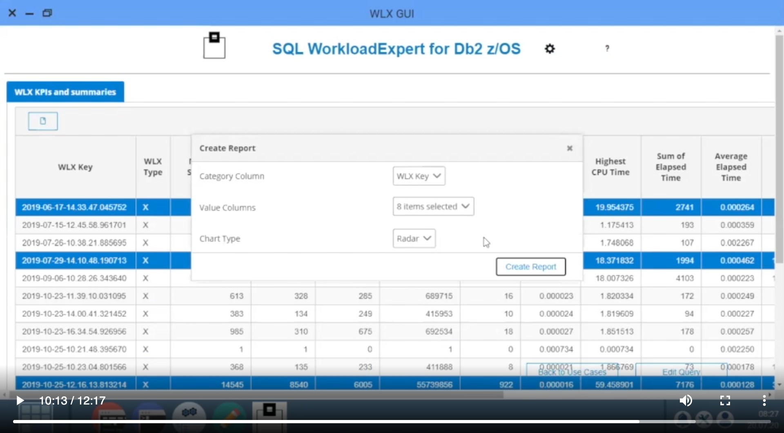
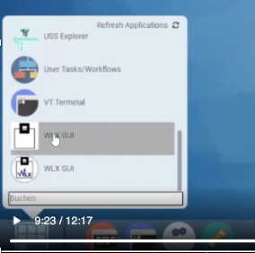
Notes:
A good way to think of the Zowe desktop and its apps is like a mobile phone.
Both come with a great set of base apps, but also have the ability to extend through additional marketplace extensions
Zowe desktop extension plugins can be provided by software vendors or even customers themselves and the Zowe extender documentation provides open source samples of how to do this together with extensive SDK documentation.
<click>
Software vendors can apply for a Zowe conformance badge to demonstrate their plugin is built to a set of defined APIs for interoperability and end user consistency.
<click>
Examples of this are Rocket BlueZone web,
<click>
And Segus Engineering SQL Workload Expert for DB2 z/OS.

Slide 41
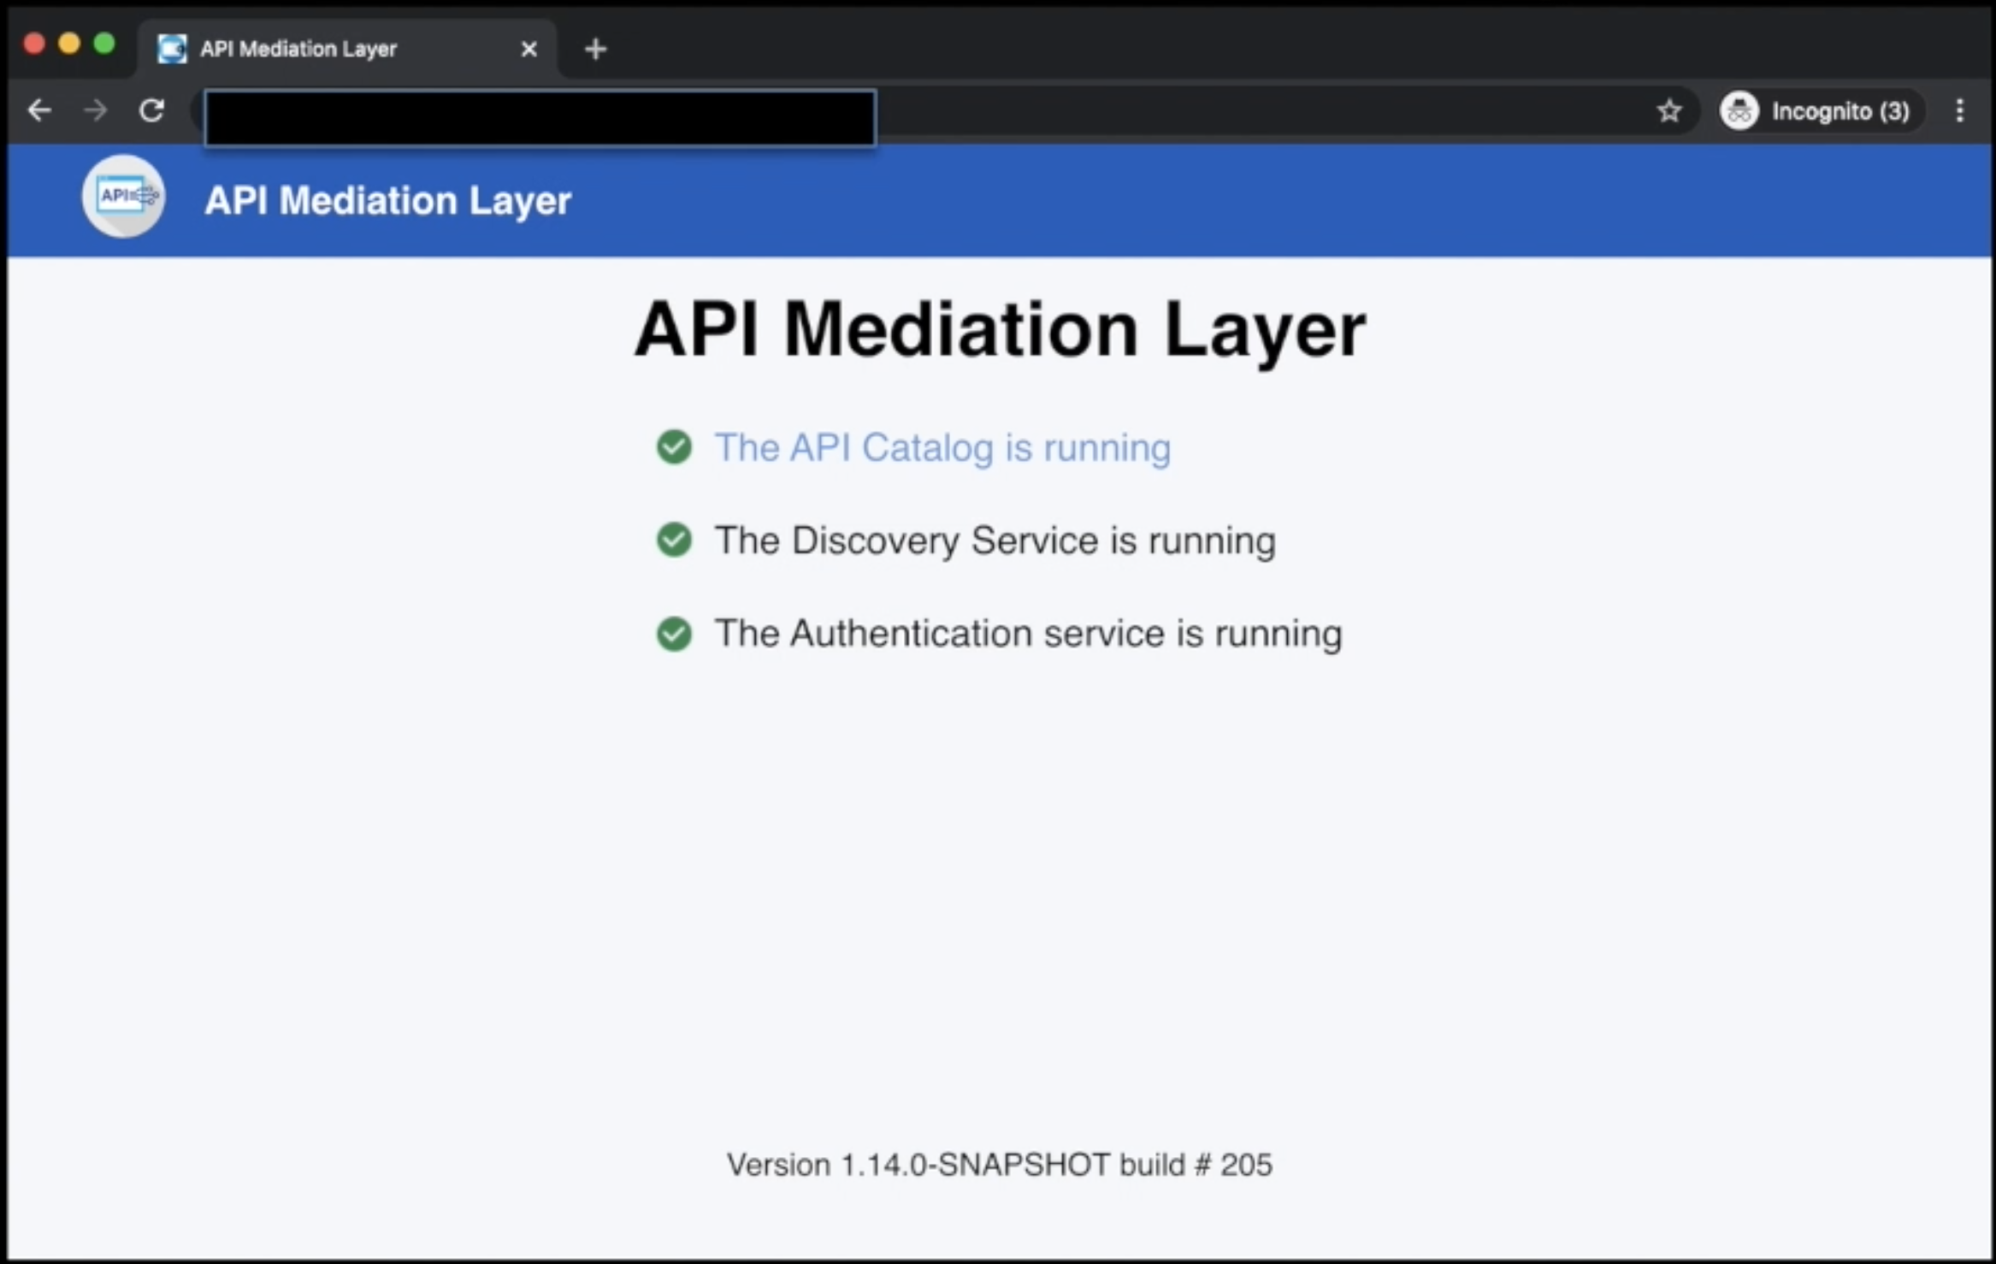
API Mediation Layer
Notes:
Underpinning Zowe's core capabilities is a powerful API Mediation Layer based on Netflix Zuul technology. This provides a catalog of API services on the mainframe

Slide 42
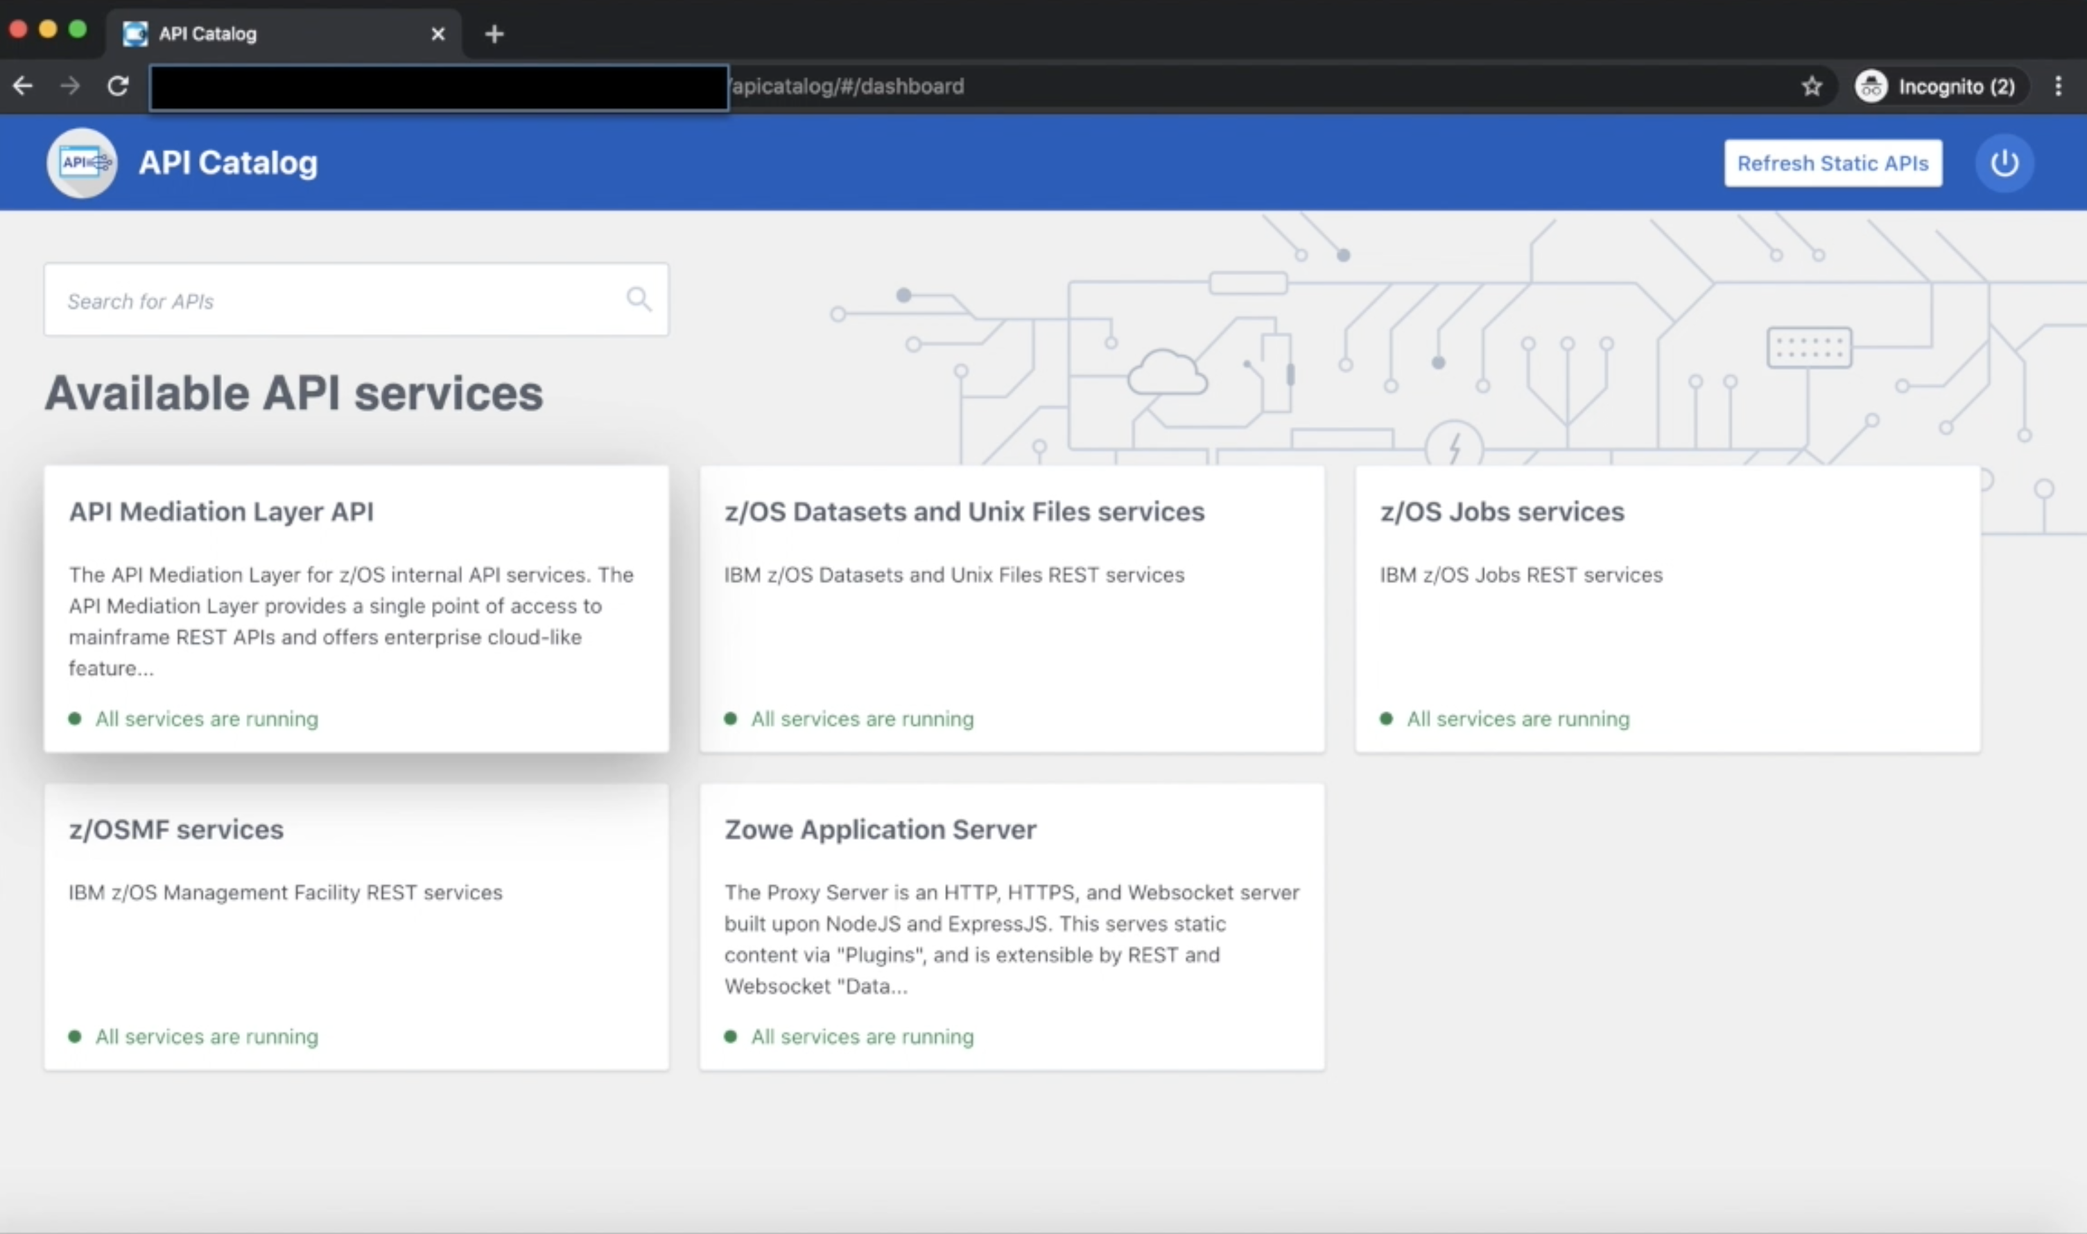
Notes:
allowing a user to actually browse and explore them

Slide 43
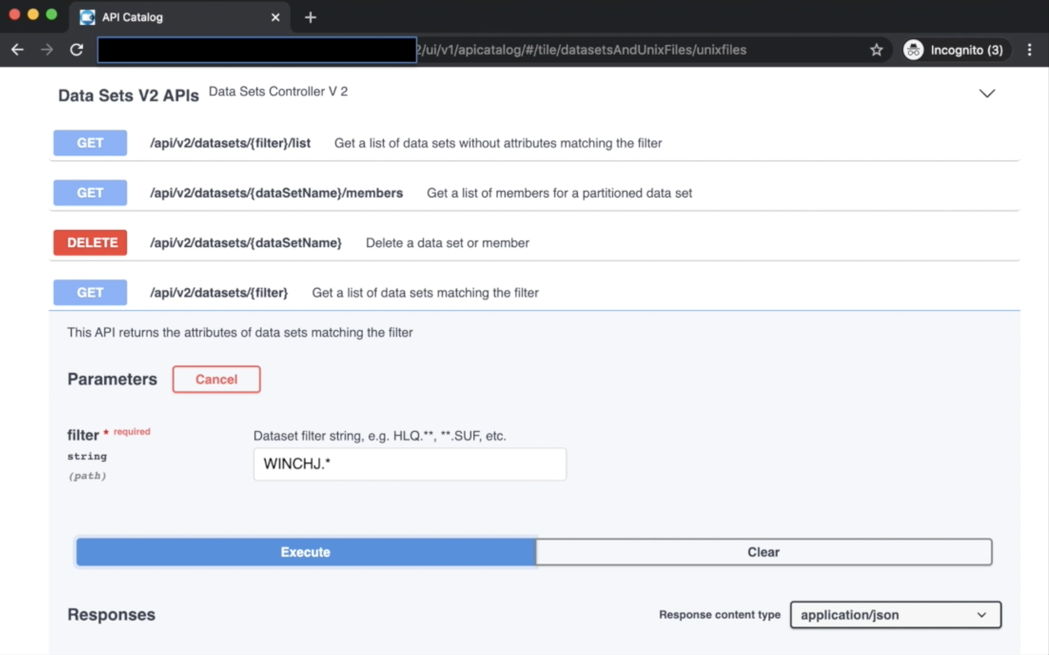
Notes:
as well as experiment with their capabilities in place

Slide 44
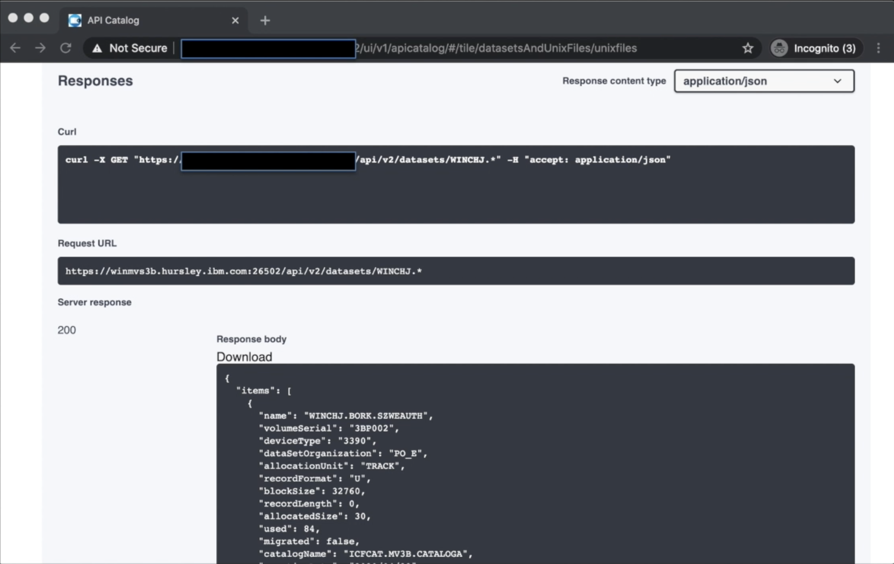
Notes:
viewing the query results.
This actually allows developers and system programmers to write their own client applications sitting on top of this benefiting from its features such as single sign-on, high availability and more.

Slide 45
Notes:
The API Mediation Layer is the engine that provides all of these services, the sister components: the CLI, the Zowe Explorer and the Zowe desktop.

Slide 46
We are building more than technology.
We are building a community.
Notes:
As you've seen, Zowe provides base capabilities in its core to allow mainframers from all generations to enjoy access to the platform to a wide number of form factors. At its heart are open source ideas to embrace API's extensibility plug-in based architecture, certification program for vendors.
More than the technology however, Zowe is a vibrant community with participation from many software vendors, customers, students, open source advocates, IT professionals from across the globe.

Slide 47
Zowe.org
Notes:
If you'd like to join us, please visit zowe.org

